Slide 1
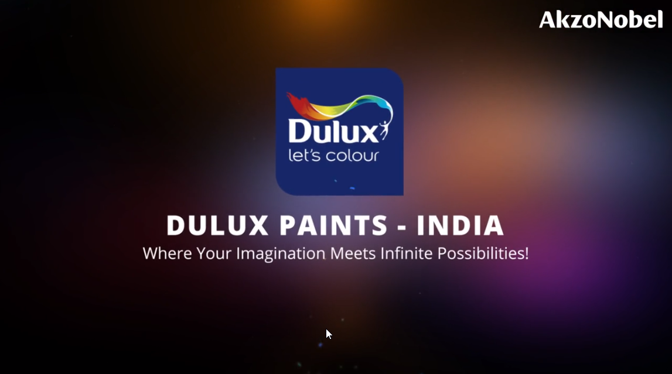
MALAYSIA
Notes:
VO:Welcome to the vibrant world of colors with Dulux Paints Malaysia; where your imagination meets infinite possibilities. Click Start to begin.
Developer Notes: This is the standard starting animation that will play. Start button to be highlighted so that users knows he/she has to click it.

Slide 2
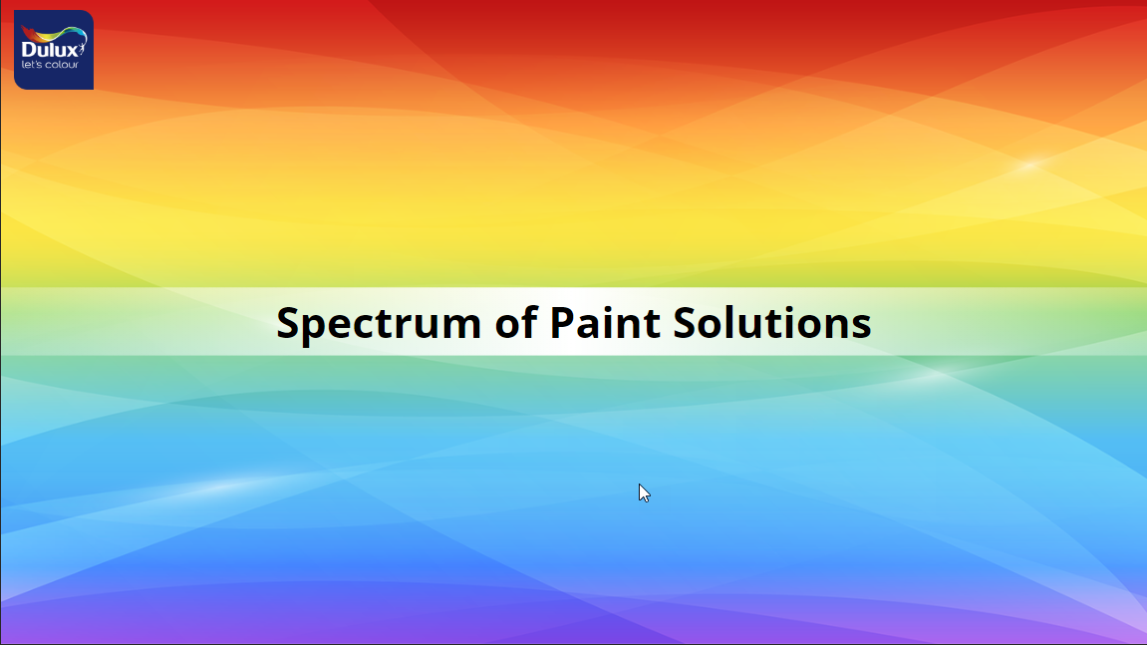
Notes:
VO: We offer a spectrum of paint solutions each catering to specific needs and aesthetics.

Slide 3



INTERIOR PREMIUM WALL PAINT
INTERIOR MASS & ECONOMY WALL PAINT
EXTERIOR PREMIUM WALL & ROOF PAINT
EXTERIOR MASS WALL PAINT
TRIMS PREMIUM PAINT
TRIMS MASS PAINT
WOODCARE PREMIUM PAINT
WATERPROO-FING PREMIUM PAINT
PRE DECO
Click each tile to know more about the specifics of that category
Notes:
Voiceover (VO): Our Categories include the following: (Animate the rectangles in sync with audio)
INTERIOR PREMIUM WALL PAINT
INTERIOR MASS & ECONOMY WALL PAINT
EXTERIOR PREMIUM WALL & ROOF PAINT
EXTERIOR MASS WALL PAINT
TRIMS PREMIUM PAINT
TRIMS MASS PAINT
WATERPROOFING PREMIUM PAINT
PRE DECO
OST: Click each tile to know more about specifics of that category.
Developer Notes: The shapes should be clickable. Clicking the shape should take it to the respective section of the course. This should be open navigation, use can click any of the shapes first to begin. On Mouse hover, the colour of the shape should change and it should be highlighted. Once visited, there should be a tick mark on the shape to denote that it has already been viewed.

Slide 4
INTERIOR PREMIUM WALL PAINT
Notes:
Developer Notes: This section should be played when the user selected the tile Interior Premium Wall Paint.

Slide 5
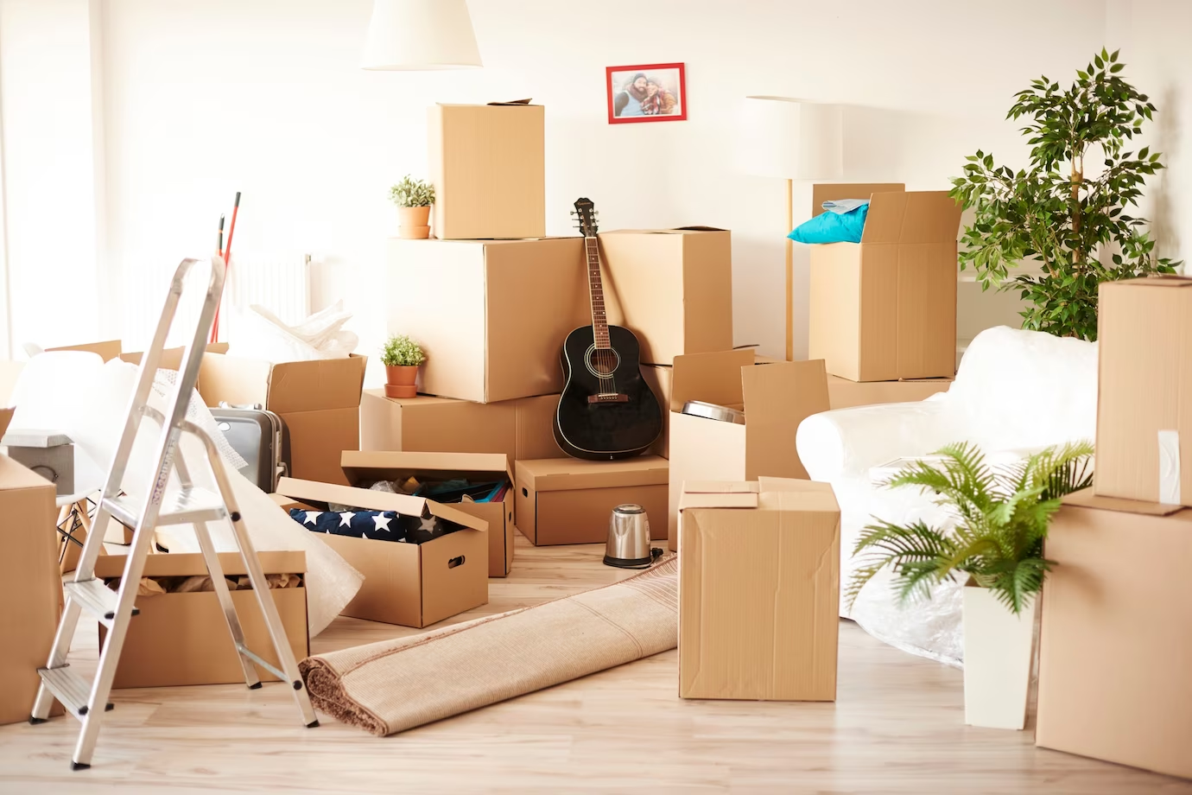
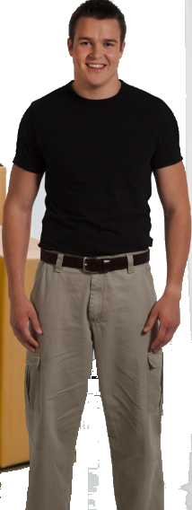
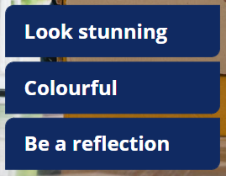

Voiceover has changed. Need to add images of different rooms to slide after family is shown.
Introduction to scenario
Background changed, pose needs to change in second sentence when audio says Ahmad is confused…
Stunning & Colourful walls
Reflecting their personality
Safe and easy to clean
Notes:
Photo link.: New BG: https://www.freepik.com/free-photo/top-view-messy-full-moving-boxes-room_15973330.htm#query=new%20home%20empty%20with%20boxes&position=11&from_view=search&track=ais&uuid=839e9e2b-c760-4f8b-85fb-b6c15321ddfb
Updated VO: Meet Ahmad who is moving into his new home with his family. He wants their home to look stunning, colourful and be a reflection of their personalities. Above all, he would like their home to be safe, easy to clean and stain resistant. Ahmad is confused with the wide variety of paints and colours to choose from, lets help him to select the best option for his needs. Click next to proceed.
Notes to developer: Need to do a slow zoom in this image while the voice over is being narrated. Bullet points need to be added in sync with audio.

Slide 6
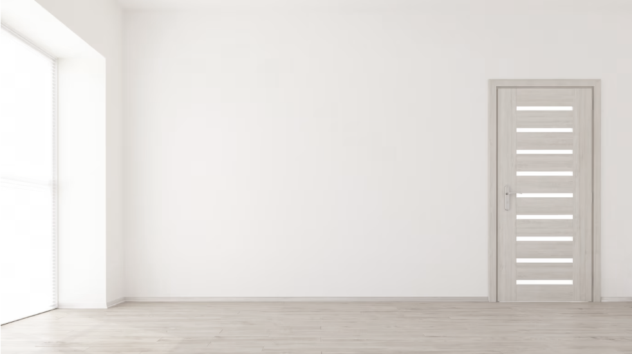
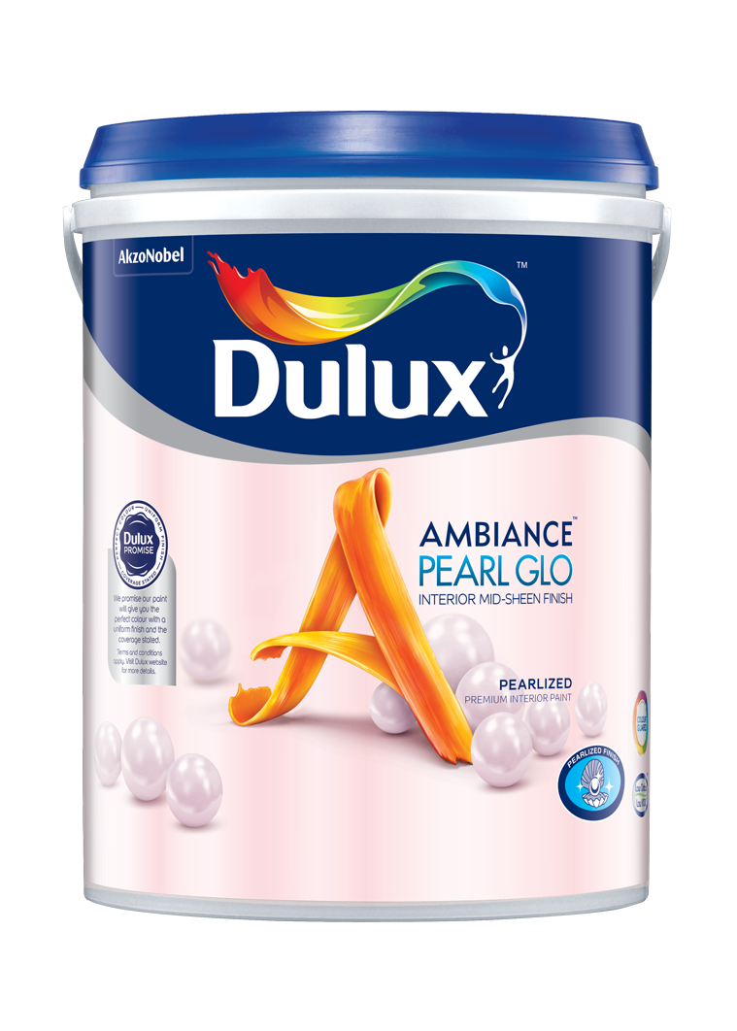
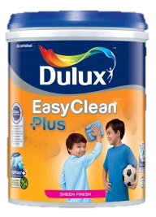
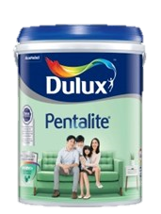
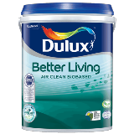
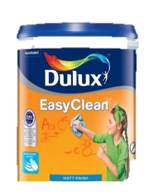

Character on this slide has changed from Ahmad to narrator
INTERIOR PREMIUM WALL PAINT
Dulux Better Living Air Clean Biobased
Dulux Ambiance Pearl Glo
Dulux EasyClean Plus /EasyClean
Dulux Pentalite
Click on each type to learn more
Notes:
VO: Here is where Dulux offers a variety of paint solutions to Ahmad for his specific needs. Let’s help Ahmad select the perfect option basis his needs. (After this the paint buckets appear)
OST: Click on each type to learn more.
Image referece:1. https://www.freepik.com/free-photo/3d-render-empty-room-interior_5027779.htm#query=new%20home%20empty&position=14&from_view=search&track=ais&uuid=3d7d3747-a661-4529-80e0-83bfd7f478da (background)
2. https://www.freepik.com/free-photo/pensive-man-eyeglasses-looking-aside_7370466.htm#query=asian%20man%20glasses&position=18&from_view=search&track=ais&uuid=8d52b750-945b-4792-97a7-d252abbb4084
(Asian Man thinking keywords)

Slide 7
INTERIOR PREMIUM WALL PAINT
Dulux Better Living Air Clean Biobased
Dulux Ambiance Pearl Glo
Dulux EasyClean Plus /EasyClean
Dulux Pentalite
Click on each type to learn more
Notes:
Developer Reference: This slide to be shown when user clicks Dulux Better Living Air Clean Biobased

Slide 8
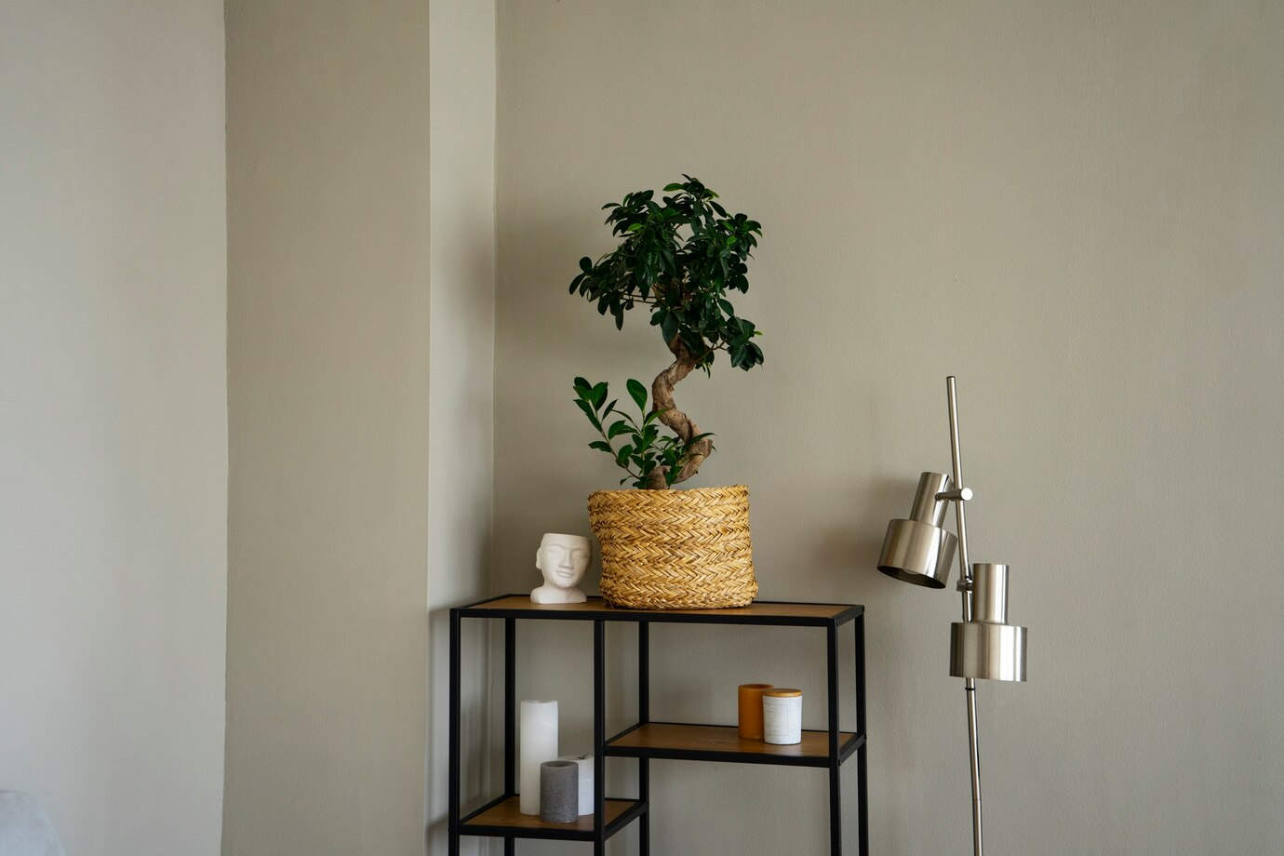



Introduction
Dulux Better Living Air Clean Biobased
Voiceover has changed.
Background changed, new icons added
Navigation is auto proceed to next slide i.e. Problem statement
Notes:
VO: Dulux Better Living has a unique PureAir technology (show first icon) that uses biobased ingredients and this property allows it to purify indoor air. It is a U.S.D.A (show second icon) certified product and contains natural ingredients which help in reducing harmful impact of formaldehyde and other VOCs. Let’s explore how this can fit Ahmad’s first requirement.
Notes: Use Fade transition to move to next slide.
Image: https://www.freepik.com/free-photo/creative-inspirational-resource_19869962.htm#query=blank%20brick%20wall%20with%20a%20table&position=27&from_view=search&track=ais&uuid=c123f59f-07f7-45ad-ae22-655b8ebea06e

Slide 9
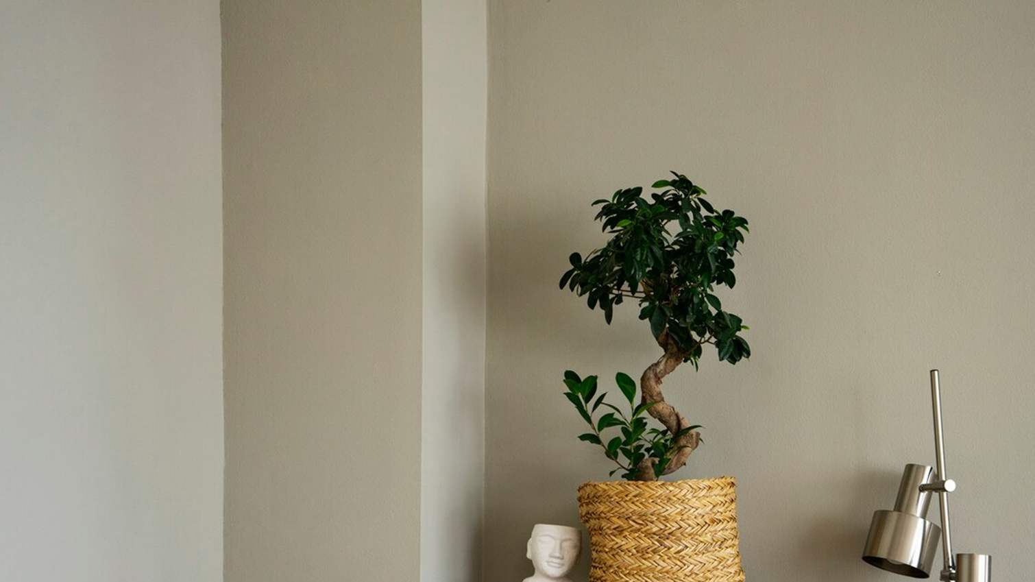
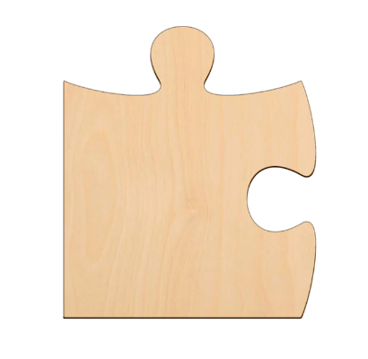
Problem Statement:
Ahmad voice: I spend a lot of time at home now
Ahmad voice audio 2: I want to make my home feel safer and use natural elements to make me feel comfortable and therapeutic
Voiceover has changed.
Background changed, new icons added
Click the puzzle icon to view Ahmad’s first requirement
Notes:
OST: Click the puzzle icon to view Ahmad’s first requirement. (At the start of the screen show the jigsaw icon only, thought bubbles appear later on clicking) Thought bubble 1: I spend a lot of time at home now. Thought bubble 2: I want to make my home feel safer and use natural elements to make me feel comfortable and therapeutic
VO: 1. Due to hybrid working, I spend a lot of time at home now. I want to make my home feel safer and use natural elements to make me feel comfortable and therapeutic.
Notes: Change pose of Ahmad between 2 sentences. Both poses need to have ahmad in thinking pose with hands folded across chest or hands on chin (thinking) Speech bubbles change and only 1 is shown at 1 point. Do not show both together.
Image is from previous slide.

Slide 10
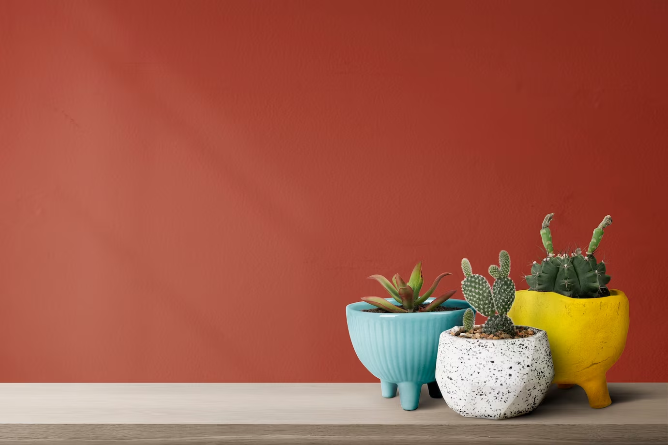
Benefits
Voiceover has changed. No characted. Female common voiceover.
Background changed, new icons added
Navigation is click next to proceed
Notes:
VO: (plays after paint can is shown). The Dulux Better Living series of paints contains Pure Air Technology and is USDA certified and it helps clean the internal air by removing harmful impacts of formaldehyde and other Volatile Organic Compounds (commonly called VOCs). Also, it is made using naturally occurring ingredients such as active bamboo charcoal and is therefore environmentally friendly too. This is perfect based on Ahmad’s requirements.
Animation Description: Bring an image of the Dulux Better Living sliding from right side into the frame. Character expression should change from being thoughtful to smiling once the paint image is shown. The 3 bullet points should be displayed in synchronisation with the spoken audio. At one point only 1 icon and 1 text to appear. Then second, then third. At the end, all three should appear and wait for user to click next. Click Next to proceed audio or show blinking icon for next.
Icon 1 in sync with Pure air technology, Icon 2 with USDA certified and Icon 3 comes later in sync with naturally occurring ingredtients..
Image Ref: https://www.freepik.com/free-photo/small-cacti-with-red-wall-background_16235022.htm#query=home%20intereior%20natural%20colours&position=35&from_view=search&track=ais&uuid=2f22660b-b2b4-4bca-ac75-ec1c9a606232#position=35&query=home%20intereior%20natural%20colours
Character photo ref:

Slide 11
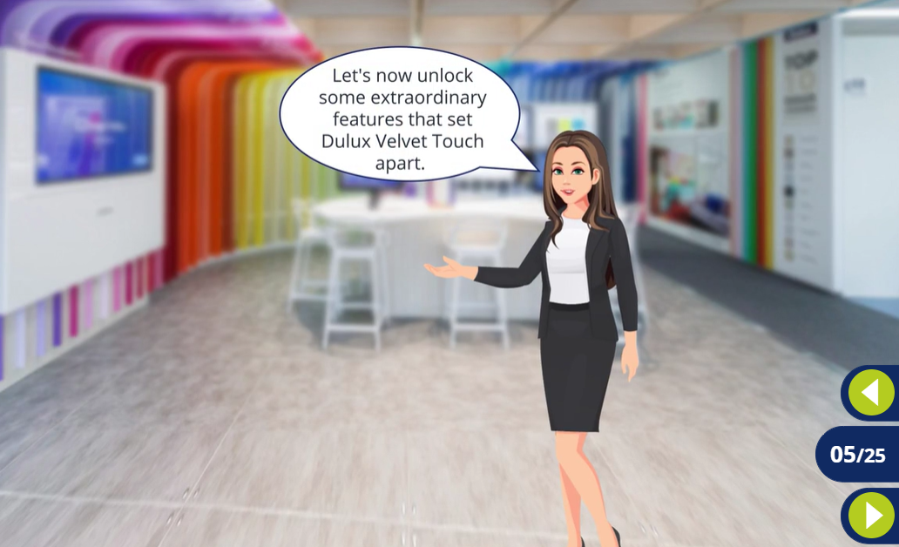
Voiceover has changed.
NEW SLIDE ADDED
Notes:
VO: Lets now unlock some extraordinary features that set Dulux Velvet Touch Apart.

Slide 12
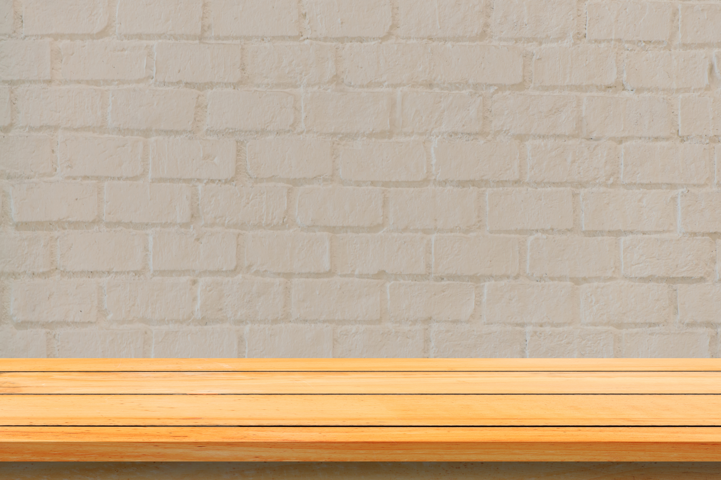
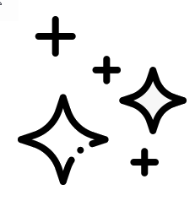





Features
Voiceover has changed. Background to be used as per Storyline File.
Coverage: 11-12 mt²/Lt
mts²
Finish: Sheen
Drying time:
2-3 hrs
Anti Bacterial
>1200 shades
Water based
1L, 5L buckets
Click the product to learn more.
Notes:
VO: Click each of the icons to learn more.
Dulux Better Living Air Clean Biobased is Water based environmentally friendly.
It has Anti bacterial and anti fungal properties
Also, it Finishes with a good sheen and luster
This paint can Cover more area with less paint, and usually covers11-12 square meters per liter.
This has a Quick drying time of 2-3 hours.
You can choose from over 1200 soft pastel colors to personalize your space.
Dulux Better Living Air Clean Biobased is Available in 2 sizes, which are1L and 5L buckets.
Developer Notes
Show OST in sync with the VO (User needs to click only once, and the icons appear one after the other in sync with audio)
*******EXISTING ICONS FROM INDIA STORYLINE FILE CAN ALSO BE USED INSTEAD OF THIS DEPENDING ON CLIENT REQUIREMENT. PLEASE CONFIRM WITH PROJECT MANAGER WHICH ICONS ARE BETTER TO BE USED IN THE STORYLINE FILE ************
Icon references: (For icons on this page)
Water Based Icon: https://www.flaticon.com/free-icon/water-drop_3105761?term=water&page=1&position=2&origin=search&related_id=3105761
Anti bacterial: taken from previous SB (India specific SB)
Shine: https://www.flaticon.com/search?word=shine
Coverage: Created by Me
Time: taken from PPT icons
Colors: Taken from previous India SB
Paint can: https://www.flaticon.com/free-icon/paint-can-open_81980?term=paint+cans&page=1&position=3&origin=search&related_id=81980
Paint quantity: Created by me using above paint can and scale created myself.

Slide 13
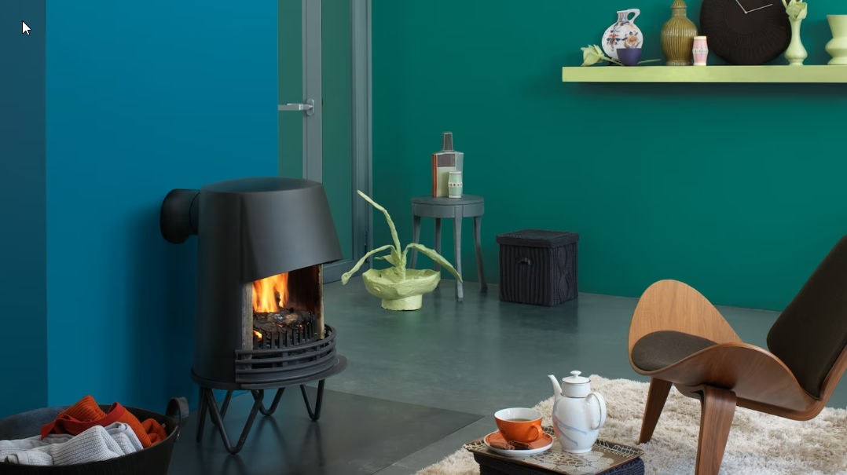
Result :
Voiceover has changed. Background to be used as per Storyline File.
New OST added
Environmentally friendly
Safe for the family
Notes:
As a result, Ahmad has his living room painted in environmentally friendly and safe colors. Now let us move his next requirement.
Developer Notes
Show Ahmad looking happy. He has fresh walls with clean air.
Navigate to Slide 6 again once this slide is over so that user can select next/different paint bucket
Image links: https://www.freepik.com/free-photo/minimalist-interior-design_72291465.htm#from_view=detail_serie

Slide 14
INTERIOR PREMIUM WALL PAINT
Voiceover has changed. Background to be used as per Storyline File.
Dulux Better Living Air Clean Biobased
Dulux Ambiance Pearl Glo
Dulux EasyClean Plus /EasyClean
Dulux Pentalite
Click on each type to learn more
Notes:
VO: You can select the next product to continue. (Use standard female voice)
Developer Notes: Imagine the user wants to select the second option here which is Dulux Ambiance Pearl Glo. First bucket needs to be shown with tick as it has been viewed. Other 3 are clickable at this point.

Slide 15
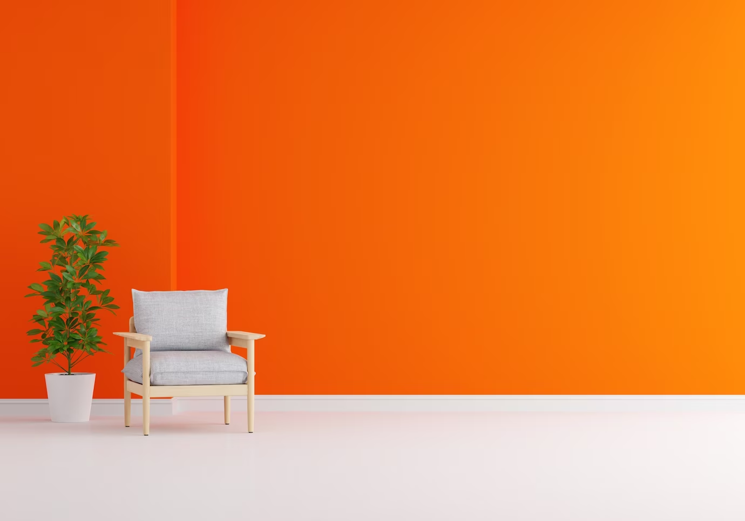
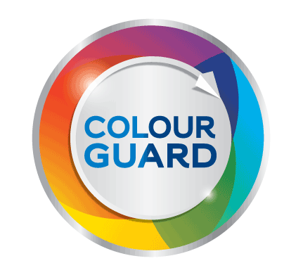

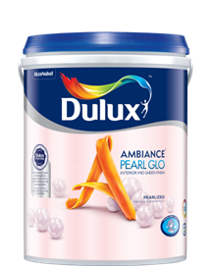
Introduction – Ambiance Pearl Glo
Voiceover has changed. Background to be used as per Storyline File.
Notes:
VO: Dulux Ambiance Pearl Glo has an attractive pearlized mid-sheen finish (icon 1) provides a timeless & elegant look to your room. It has a shimmery texture and gives off a rich look to your walls. Let’s look at Ahmad’s next requirement.
Image: https://www.freepik.com/free-photo/gray-armchair-orange-living-room-with-copy-space_14478716.htm#query=freshly%20painted%20house%20wall&position=0&from_view=search&track=ais&uuid=9fd2e8ce-9a5b-490f-9afc-6c69cb3c9b43

Slide 16

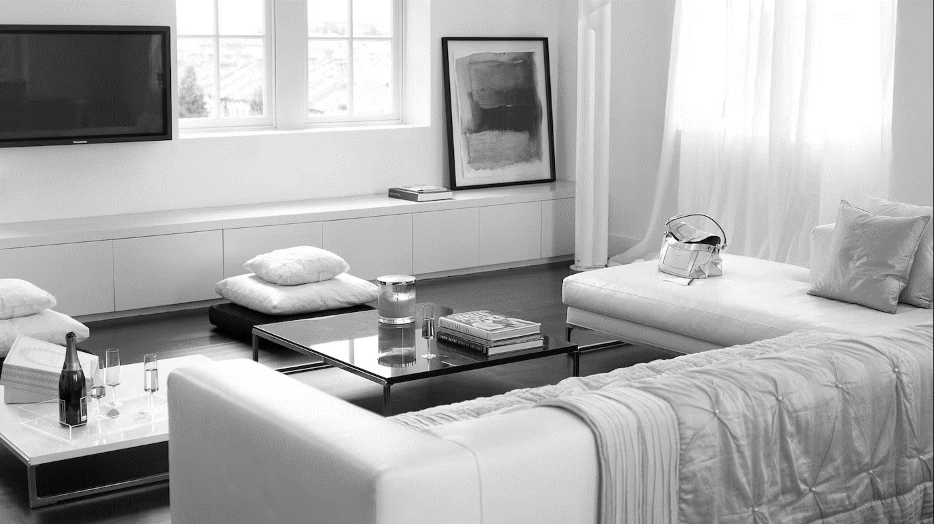
Problem Statement:
1. I like to stay on top of the current trends. . Be it my phone or my home
2. . I want my walls to have a contemporary style with latest trendy colours and an attractive interiors
Voiceover has changed. Background to be used as per Storyline File.
3. I want the best paints to be used in his dining area
Click the puzzle icon to view Ahmad’s first requirement
Notes:
VO: Now, we will view Ahmad’s second requirement, Click the puzzle icon to know the requirement. (Standard Female Narrator Voice)
(Use male Ahmad voice for below)
I like to stay on top of the current trends. Be it my phone or my home. I want my walls to have a contemporary style with latest trendy colours and an attractive interiors. I want the best paints to be used in his dining area.
Let’s see how Dulux Ambiance Pearl Glo is the best choice for his needs. (Standard Female Narrator Voice)
Image ref: https://images.akzonobel.com/akzonobel-flourish/dulux/in/dulux/en/articles/channel-modern-luxury-shades-ivory/channel-modern-luxury-with-shades-of-ivory_2.jpg?impolicy=.auto&imwidth=1366
Person Image: https://www.freepik.com/free-photo/expressive-young-guy-posing-studio_16925389.htm#&position=11&from_view=author&uuid=5957b8f4-ad4f-41bc-9352-ea2e062fa5df

Slide 17

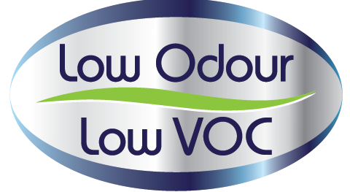
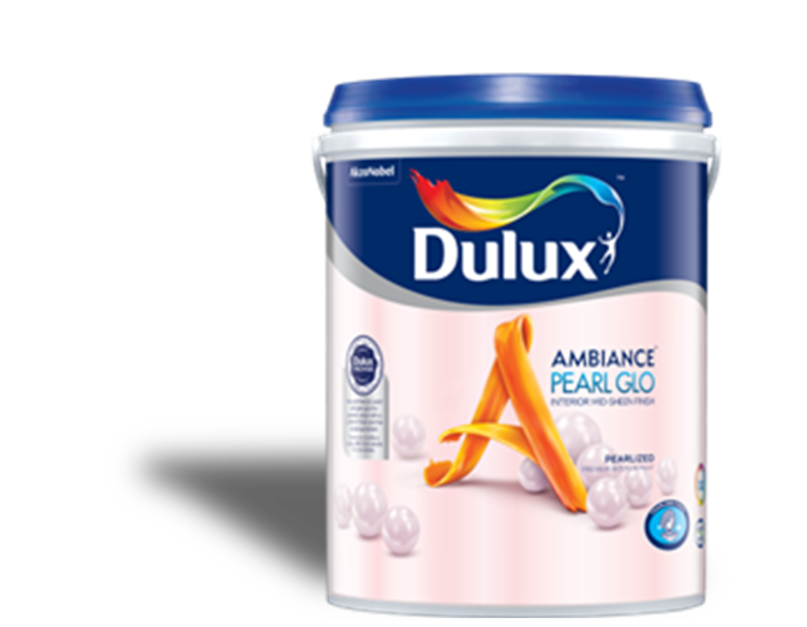
Voiceover has changed. Background to be used as per Storyline File.
Benefits
Pearlized Mid Sheen
Long Lasting colours
Low Odour, Low VOCs
Notes:
VO: (plays after paint can is shown).
The Dulux Ambiance Pearl Glo is a unique offering that has a pearly mid-sheen finish. (Icon 1 and text)
It gives a timeless look and has long lasting colours that keep your homes looking beautiful for longer time. (Color Guard Icon). It is also a low odour and low Volatile Organic Compounds (or VOC ) emitting paint. (Icon 3)
Lets unlock some extraordinary features of Dulux Ambiance Pearl Glo next. (Show the standard image after this… for reference I have put it in the inset on same page. This will be new page)
Animation Description: Bring an image of the Dulux Ambiance sliding from right side into the frame. The 3 bullet points should be displayed in synchronisation with the spoken audio. Icons to appear in sync with audio and text too.
Character: https://www.freepik.com/free-photo/expressive-young-male-posing-studio_16925419.htm#&position=1&from_view=author&uuid=5957b8f4-ad4f-41bc-9352-ea2e062fa5df

Slide 18
Features
Voiceover has changed. Background to be used as per Storyline File.
Coverage: 11-12 mt²/Lt
Drying time:
2-3 hrs
mts²
Finish: Pearlized Mid Sheen
>2500 shades
Water based
1L, 5L & 18 L
Click each icon to learn more.
Notes:
VO: Dulux Ambiance Pearl Glo. Click the paint icon to learn more.
Dulux Ambiance Pearl Glo is a Water based environmentally friendly paint that gives your walls an attractive pearly texture.
It has a pearly mid-sheen finish that will make walls look attractive and timeless
It has excellent paint coverage. It usually covers with 11-12 square meters per liter.
This paint has Quick drying time of 2-3 hours.
It has over 2500 colors to choose from.
This product is Available in 3 sizes depending upon requirement. The sizes available are1L, 5L & 18L buckets.

Slide 19

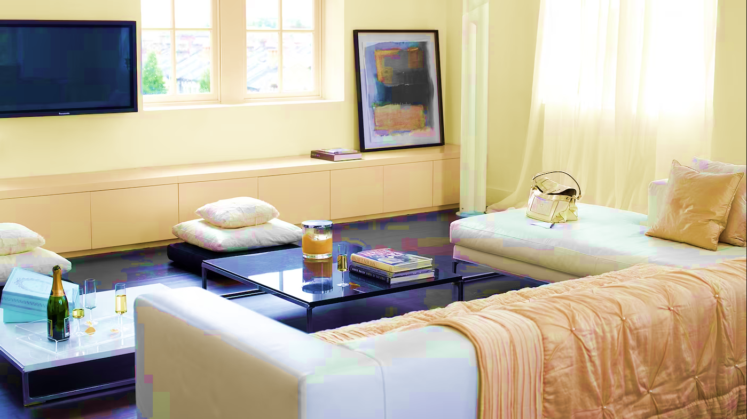
Results
Voiceover has changed.
Notes:
As a result, Ahmad has his living room painted in an attractive and long lasting paint coating with a timeless look.
Developer Notes
Show Ahmad looking happy. His living room looks timeless and elegant.
2 Navigate to Slide 6 again once this slide is over so that user can select next/different paint bucket
Image Ref: https://www.freepik.com/free-photo/expressive-young-guy-posing-studio_16925350.htm#&position=3&from_view=author&uuid=5957b8f4-ad4f-41bc-9352-ea2e062fa5df#position=3

Slide 20

INTERIOR PREMIUM WALL PAINT
Dulux Better Living Air Clean Biobased
Dulux Ambiance Pearl Glo
Dulux EasyClean Plus /EasyClean
Dulux Pentalite
Click on each type to learn more

Slide 21
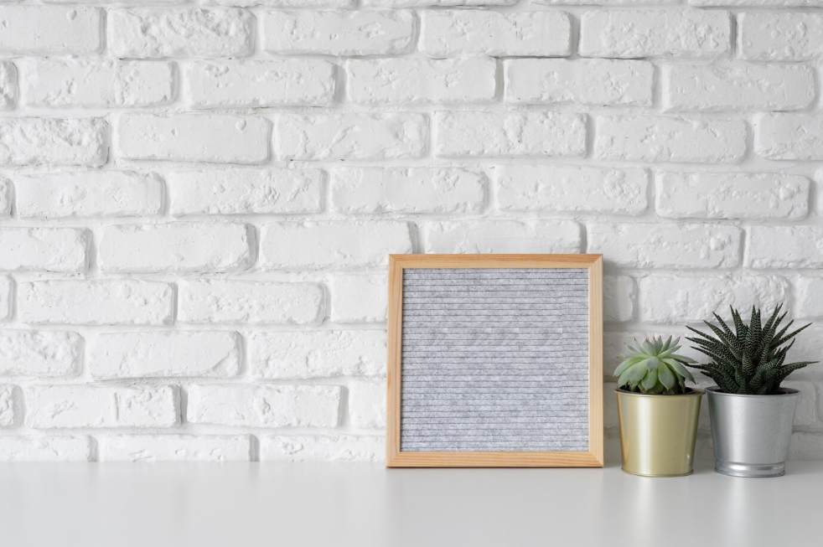
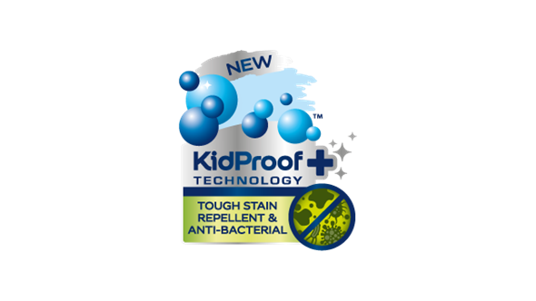

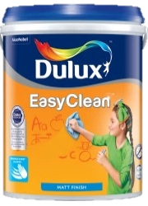

Introduction
Dulux EasyClean Plus and
Dulux EasyClean
Notes:
VO: Dulux Easy Clean and Easy Clean Plus are two products which are don’t allow common household stains from penetrating into the paint. They can be easily wiped away, leaving walls looking fresh and clean. They have colour guard technology and Kidproof+ technology (EasyClean Plus) which keep walls looking clean and fresh for years. The difference between these two are the types of finish it provides. One has a sheen finish(EasyClean Plus), while the other has a matt finish (EasyClean)
Image: https://www.freepik.com/free-photo/creative-inspirational-resource_19869962.htm#query=blank%20brick%20wall%20with%20a%20table&position=27&from_view=search&track=ais&uuid=c123f59f-07f7-45ad-ae22-655b8ebea06e

Slide 22
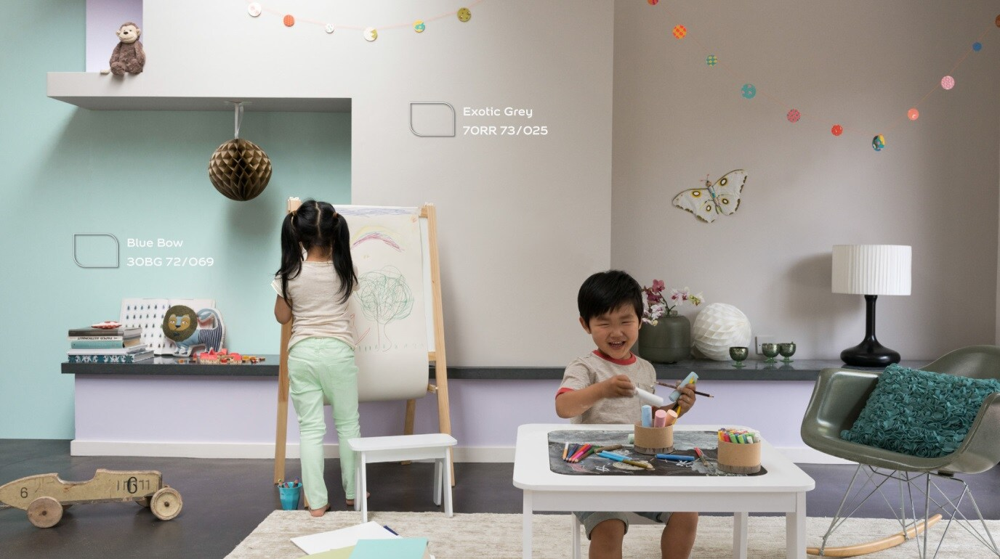
Problem Statement:
VO Changed from Maria and Ahmad to only AHMAD as per client feedback. Please note.
Is ahmad should speak here or the character
Notes:
VO: Click the puzzle icon to understand Ahmad’s requirement for his kids room.
VO: I have two children aged 6 and 3. My little artists are fond of creating artwork everywhere including the walls in the house.
I am looking for a solution where my walls look beautiful and yet are washable and easy to clean.
Narrator VO: Let’s check what Dulux has to offer them in this situation. Click next to proceed.
Image Ref: https://www.dulux.com.my/en/colour-inspiration/farawayplaces

Slide 23
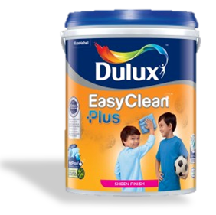
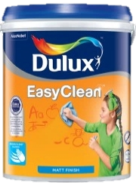

Benefits
Sheen Finish
Matt Finish
Kidproof+ technology
ColourGuard Technology, Easy Cleaning Function
Antibacterial and
Anti virus protection
Antibacterial protection
Notes:
VO: (plays after paint can is shown). The Easy Clean Plus range comes in either a Sheen finish and has advanced Kidproof+ technology in it. It allows for easy cleaning of stains, and also protects against bacteria and viruses. While the EasyClean range comes with ColourGuard Technology. This makes walls resistant to permanent stains by having easy to clean properties. This ensures that walls remain looking fresh and clean for longer periods as compared to traditional paint finished.
It ensures your walls remain clean and can withstand tough stains, making them easy to wash and spotlessly clean walls.
Click next to view the detailed features.
Animation Description: Bring an image of the Dulux Ambiance sliding from left side into the frame. The two sets of 3 bullet points should be displayed in synchronisation with the spoken audio. Icons can appear and disappear along with audio.

Slide 24
Coverage: 11-12 mt²/Lt
Features
mts²
Anti Bacterial
Drying time:
2-3 hrs
Finish: Sheen / Matt
>2500 shades
Water based
1L, 5L & 18 L
Click each icon to know more.
Notes:
VO: Let's now unlock some extraordinary features that set Dulux Easy Clean and EasyClean Plus. Click each icon to learn more.
The Dulux Easyclean paints Water based environmentally friendly.
They are Anti bacterial and anti fungal properties which offers an added layer of protection to your walls
Finishes with a sheen for Dulux EasyClean Plus and a matt finish for the Dulux Easy Clean.
Cover more space with less paint, with 11-12 square meters per liter.
Quick drying time of 2-3 hours.
Choose from over 1200 soft pastel colors to personalize your space.
Available in 2 sizes, which are1L and 5L buckets.

Slide 25

Results
VO Changed from Maria and Ahmad to only AHMAD as per client feedback. Please note.
Walls that are:
Easy to Clean
Healthier Home
Fresh looking walls for longer
Need not show children
Notes:
VO: Thanks to Dulux’s Dulux EasyClean Plus and Dulux EasyClean products, Ahmad can be assured that his children have the freedom to have fun, and their walls will also stay fresh and clean.
Their walls are now:
Easy to Clean
Contributing to a Healthier Home
Great looking walls for longer
Image Reference: https://www.freepik.com/free-photo/smiling-portrait-girl-standing-against-white-brick-wall-holding-paintbrush-colorful-palette_4142123.htm#page=4&query=asian%20kid%20painting%20walls&position=13&from_view=search&track=ais&uuid=612b4766-1cba-4e6f-978c-f674f0fb95f3
Navigate to Slide 6 again once this slide is over so that user can select next/different paint bucket

Slide 26
INTERIOR PREMIUM WALL PAINT
Dulux Pentalite
Dulux Better Living Air Clean Biobased
Dulux Ambiance Pearl Glo
Dulux EasyClean Plus /EasyClean
Click on each type to learn more

Slide 27
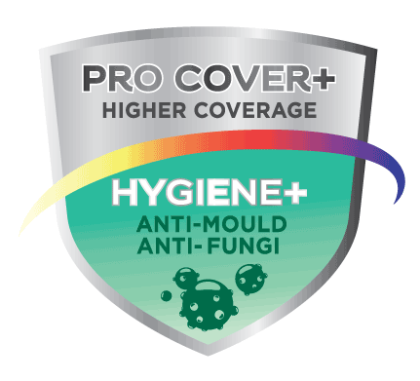
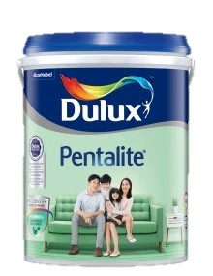
Introduction
Dulux Pentalite
Notes:
VO: We have the Dulux Pentalite that contains unique ProCover+ & Hygiene+ ingredients that give it ability to combat disease causing mould & fungus. Along with this, it comes with Colour Guard technology that keeps walls looking fresh for longer. Dulux Pentalite helps keep your homes protected, looking good while also ensuring your family’s health and well being.
Notes: Bring in the icons one by one, finally all of them must be shown in a single line. User to click Next to proceed.

Slide 28
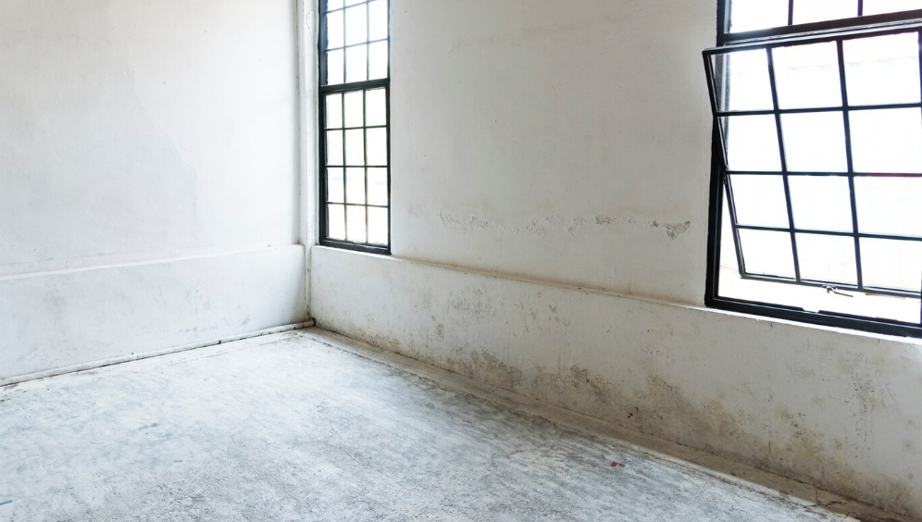
Problem Statement:
Damp walls, fungal infections, childrens health is affected
Character has to be kept as Ahmad. VO is updated to match.
Click the puzzle icon to learn about Maria’s requirement.
Notes:
OST: Click the puzzle icon to learn about Ahmad’s next requirement.
Note: We need male voice if available In this slide**** (Ahmad is different character)
VO: Due to the Prescence of dampness in walls and ceilings, mould and fungus may appear that not only spoils the look of the house but also is harmful to health. I am worried about the health and wellbeing of my children and my family and want to safeguard them against any infections that may occur due to dampness and fungi.
Visual Description: Worried looking ahmad is thinking about potential damage being caused by dampness and other bacterial infections.
Image links:
https://www.freepik.com/free-photo/clean-windows-empty-white-house-blank_3012151.htm#query=dull%20and%20damaged%20interior%20walls&position=36&from_view=search&track=ais

Slide 29
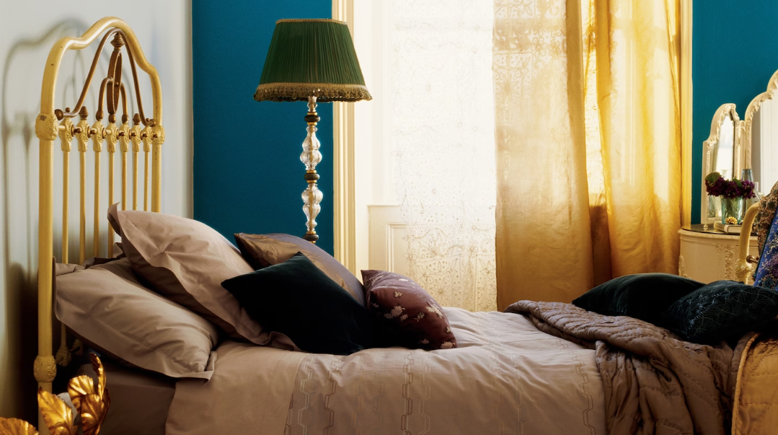
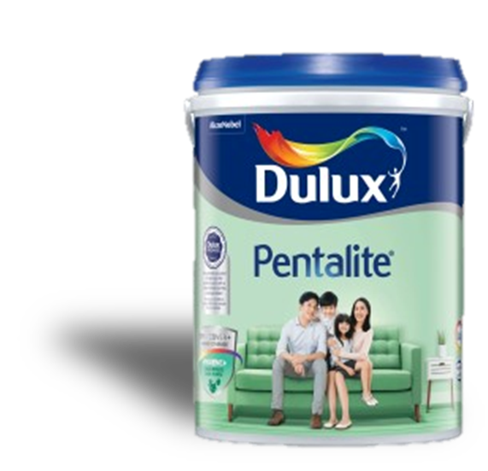
Benefits
Hygiene+ properties
ProCover+ protection
Antibacterial and
Anti virus protection
Notes:
VO: (plays after paint can is shown). The Dulux Pentalite has Hygiene+ properties and ProCover+ Protection in it. The anti-mould & fungal protect your loved ones from pathogens and also keep your walls from showing damp patches which spoil the look of your home. You get a happy healthy and good looking home with Dulux Pentalite. Click next to view the detailed features.
Animation Description: Bring an image of the Dulux Pentalite sliding from left side into the frame. The two sets of 3 bullet points should be displayed in synchronisation with the spoken audio.
Image Ref: https://www.dulux.in/en/colour-inspiration/inject-shot-glamour-deep-teal

Slide 30
Features
Coverage: 11-12 mt²/Lt
Features
mts²
Drying time:
2-3 hrs
Finish: Smooth Matt
>2500 shades
Water based
1L, 5L & 18 L
Click the product to learn more.
Notes:
VO: Let's now check some extraordinary features of this product.
Dulux Pentalite is a Water based and environmentally friendly paint.
Finishes with a Smooth matt texture which gives walls a beautiful look.
It is efficient at Covering more space with less paint, and covers 11-12 square meters per liter of paint.
Dulux Pentalite has a Quick drying time of 2-3 hours.
Choose from over 2500 shades to find the perfect shade for your home
It is Available in 3 standard sizes, which are1L, 5L and 18 Ltr buckets.

Slide 31
Results
Walls that are:
No Dampness
Lesser infections
Safe and Happy home
Notes:
VO: Ahmad is very happy with the choice of Dulux Pentalite. he does not need to worry about damp walls or her family being affected by pathogens either. his walls are protected and so is his family.
Image Ref: https://www.dulux.in/en/colour-inspiration/inject-shot-glamour-deep-teal
Image woman: https://www.freepik.com/free-photo/happy-mixed-race-woman-has-cheerful-expression-points-away-with-both-fore-fingers-says-follow-there-shows-direction-copy-space-wears-denim-clothes-white-hijab-isolated-purple-wall_11577707.htm#query=Malaysian%20woman&position=37&from_view=search&track=ais&uuid=1311889a-75c2-4715-b67f-59161586acbf

Slide 32
Notes:
VO: After exploring the various options of Interior Premium Wall paints, let’s consolidate what we learnt. Here is a comparison outlining the key features and advantages of each type of paint.
Allow user sufficient time to read this, then blink the Next button.

Slide 33
Dulux paints has given Ahmad the perfect finish and stunning look that he always wanted. He can’t wait to invite all his friends and relatives in his new house.
Notes:
VO: Ahmad is so happy that he has found the suitable paint for each of his requirements.

Slide 34
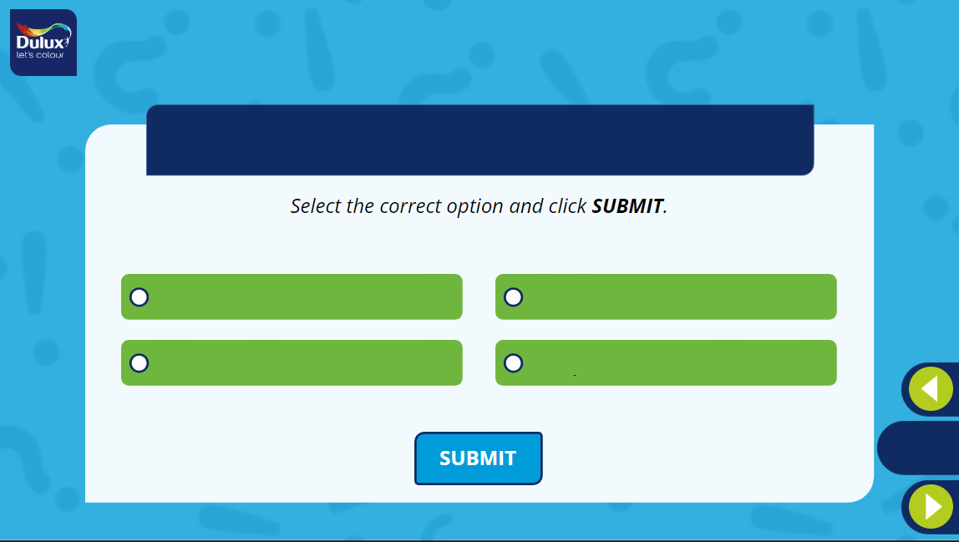
What is the unique thing about the Dulux Better Living Air Clean Biobased paints?
1
2
It has bio luminance property which makes it glow in the dark
It cleans the environment when applied to external surfaces
3
4
It has the highest sheen of all products
It has biobased ingredients which enable it to purify indoor air
Notes:
Developer Notes: Option 4 is the correct option.

Slide 35
What is the difference between the Dulux EasyClean and EasyClcean Plus?
Select all the options that apply and click SUBMIT.
(More than one option may be correct)
1
2
EasyClean Plus: Sheen Finish
EasyClean : Matt Finish.
EasyClean Plus: Solvent Based
EasyClean : Water Based.
3
4
EasyClean Plus: Kidproof+ technology
EasyClean : ColourGuard technology.
EasyClean Plus: Hard to clean
EasyClean: Hard to clean
Notes:
Developer Notes: Option1 and Option 3 are the correct options.

Slide 36
INTERIOR MASS & ECONOMY WALL PAINT

Slide 37
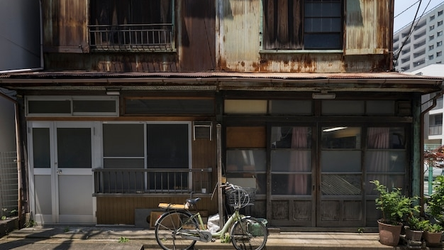

Overall Problem Statement
Notes:
VO: Bintang and his cousins live in their uncles small, old house in the southern part of the city. With the approaching festivals, they want to surprise their uncle by painting his house for him. They are looking for options to give their rooms and common areas a nice makeover. The top floor is especially in need of some repair. They want a high quality finish on a budget and are looking for options. Let’s see how Dulux’s range of paints can help them. There are several options they can choose from, however each room has a different requirement, let’s see how these different products help them.
Notes:
Image Ref:
BG: https://www.freepik.com/free-photo/haunted-house-bicycle-background_28421132.htm#page=2&query=poor%20asian%20house&position=47&from_view=search&track=ais&uuid=910811ea-b5e4-4fc0-83e3-dbe6f372a9a2
Group: Image Ref: https://www.freepik.com/free-photo/medium-shot-smiley-friends-wearing-trucker-hats_26502258.htm#query=asian%20group%20of%20youngsters%20poor&position=45&from_view=search&track=ais&uuid=b316944a-c41b-4f54-a1b7-7de81b1bcf7a

Slide 38
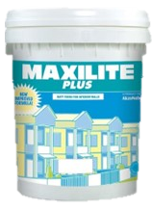
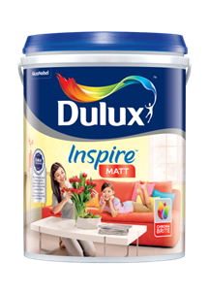
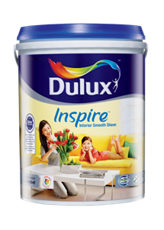
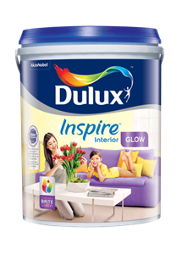
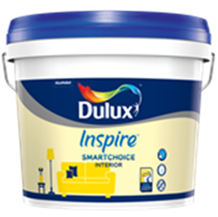
Overall Problem Statement
Notes:
VO: The Dulux Inspire range of Interior paints presents a great range of options for different needs. It provides an affordable alternative to washable paints. Let’s check out how these can help renew the appearance of Bintang’s uncles homes. Click the different products to see the details about them.
Image Ref:
BG: https://www.freepik.com/free-photo/haunted-house-bicycle-background_28421132.htm#page=2&query=poor%20asian%20house&position=47&from_view=search&track=ais&uuid=910811ea-b5e4-4fc0-83e3-dbe6f372a9a2
Group: Image Ref: https://www.freepik.com/free-photo/medium-shot-smiley-friends-wearing-trucker-hats_26502258.htm#query=asian%20group%20of%20youngsters%20poor&position=45&from_view=search&track=ais&uuid=b316944a-c41b-4f54-a1b7-7de81b1bcf7a

Slide 39
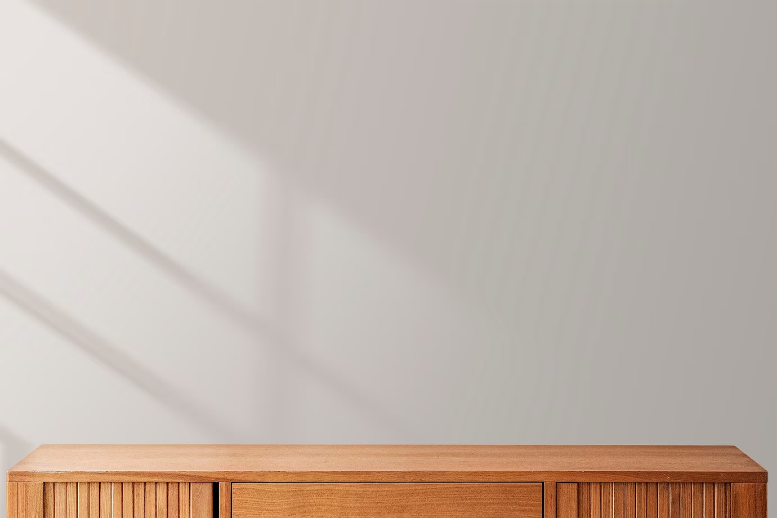
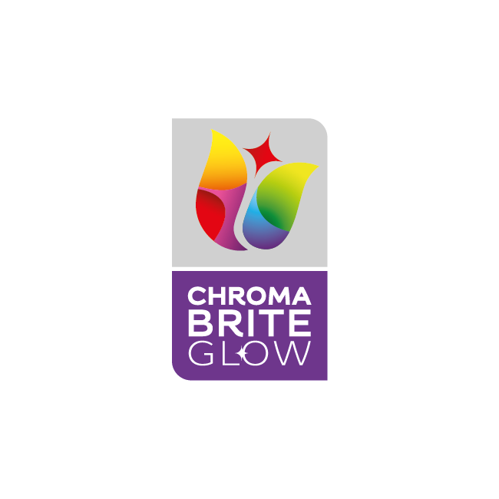

Introduction
Dulux Inspire Interior – Glow
ChromaBrite technology
High Sheen
Long lasting protection
Notes:
VO: Dulux Inspire Interior – Glow is a perfect solution for interior walls such as bedrooms. It offers a washable, high sheen paint finish at a budget. In Addition, it does not contain any Lead or Mercury. This makes it less likely to emit any odours and VOCs. (auto proceed to next slide i.e. Problem Statement)
Icons 1, 2, and 3 to appear one by one and finally stay on screen till user clicks next.
Image Ref: https://www.freepik.com/free-photo/minimal-product-backdrop-with-wooden-cabinet_15667366.htm#query=wall%20with%20shelf&position=45&from_view=search&track=ais&uuid=03401b9d-5e02-493a-b83e-86ac6b56b47b

Slide 40
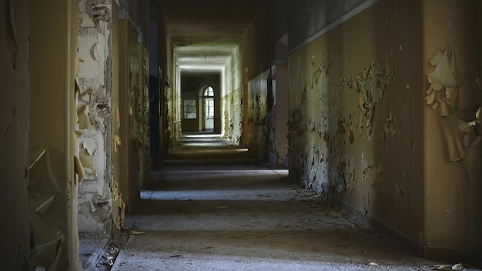
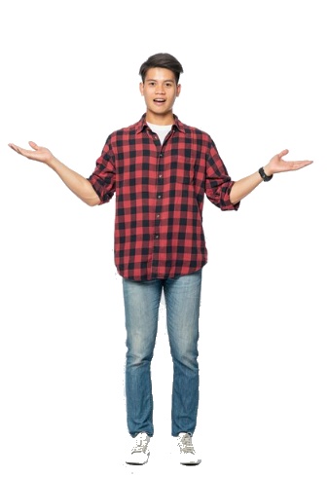
Problem Statement
Ground Floor Hallway
Hallways get dirty quicker with smudges, hand prints and other stains
Click the puzzle icon to see the
Notes:
VO: Let’s explore how Dulux Inspire range can solve Bintangs problem. Click the puzzle icon to see the first challenge Bintang faces. (this is standard female narrator voice)
Male Voice of Bintang VO: The hallway is always used by everyone living in the household. Walls get dirty quicker with smudges, hand prints and other stains. I need a washable paint but within my budget.
Dulux Inspire Interior – Glow is a perfect solution for this, as it offers a washable, high sheen paint finish at a budget. Click Next to proceed.
Image Ref: https://www.freepik.com/free-photo/hallway-abandoned-building-with-aged-walls-lights_10728678.htm#query=malaysian%20house%20hallway%20dirty&position=10&from_view=search&track=ais&uuid=070be648-0ee5-4d8f-ac6d-3d8895f3f752
***Image should be of Asian male about 24-28 years of age. In different poses.

Slide 41
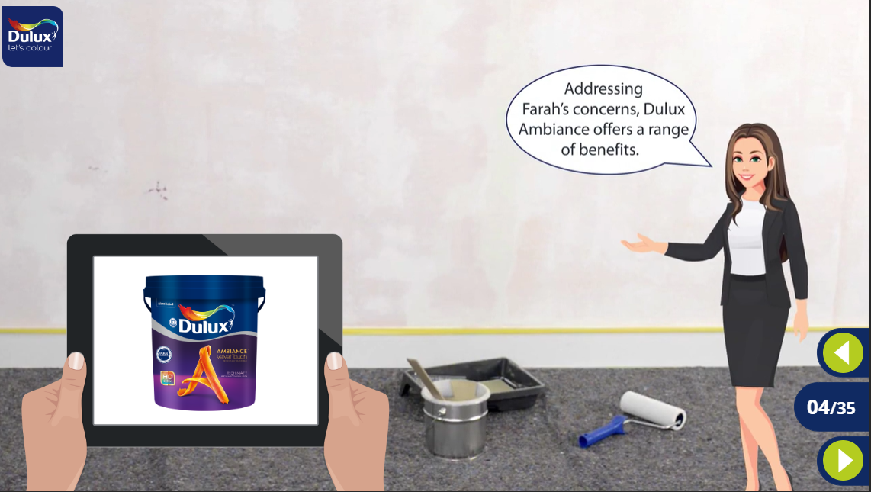
Addressing Bintang’s concerns, Dulux Inspire Interior Glow offers the best solution.
Sample benefit slide, therefore it is split into multiple slides. From next time, I will show in a single slide.
Notes:
NOTE: THIS SINGLE slide is split into 3 slides to show how animation looks, Please follow similar style for all further benefit slides.
VO: Addressing Bintang’s concerns, Dulux Inspire Interior Glow offers the best solution.

Slide 42
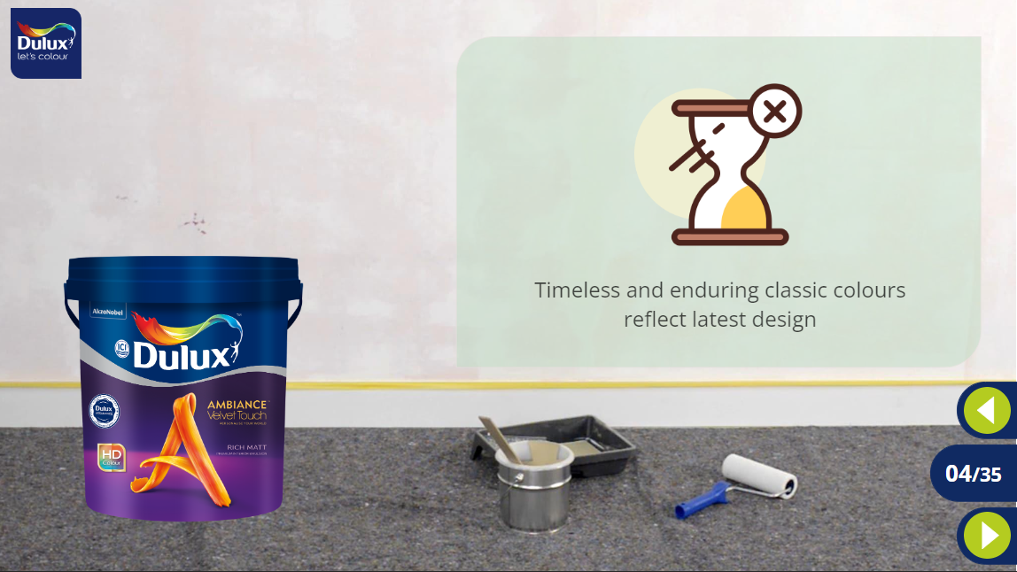

2
3
Keeps walls brighter for longer.
Note: Final Look should be like so. Zoom and look for clarity.
Notes:
Same narrator female VO: Dulux Inspire Interior Glow contains ChromaBrite technology that keeps walls appearing brighter for longer periods of time. (First Icon and text should appear so)
As stated earlier, it does not contain any lead or mercury. (Second icon) Therefore it has a low odour and emits low amounts of VOCs. (Icon 3)
Notes: Icons are only for developer to understand. We need not show this. Final appearance of slide should be as shown in the small box. Small box is only to show developer, we don’t need to show it in final slide.

Slide 43





Features
Coverage:
10-11 mt2/Lt
Good Opacity
Finish: High Sheen
1 Ready mix
>2500 shades
1L, 5L & 18 L
Notes:
VO: Let's now unlock some extraordinary features of Dulux Inspire Interior Glow .
Dulux Inspire Interior Glow has a High sheen finish.
Cover more space with less paint, with 10-11 square meters per liter.
It has good opacity which enables it to cover all existing imperfections in walls.
Choose from over 2500 shares with a single ready mix
Available in 3 standard sizes of 1, 5 and 18 litre packaging

Slide 44

Hallway looks beautiful
Clean and Safe
Long lasting protection
Notes:
VO: Bintang is very happy with the way the hallway looks now. The hallway looks beautiful, clean and safe and has long lasting protection now.

Slide 45
Overall Problem Statement
Notes:
VO: Click the different products to see the details about them.
Notes: The first paint can should be shown with a tick mark to denote completion. The others must be available choices.
Image Ref:
BG: https://www.freepik.com/free-photo/haunted-house-bicycle-background_28421132.htm#page=2&query=poor%20asian%20house&position=47&from_view=search&track=ais&uuid=910811ea-b5e4-4fc0-83e3-dbe6f372a9a2
Group: Image Ref: https://www.freepik.com/free-photo/medium-shot-smiley-friends-wearing-trucker-hats_26502258.htm#query=asian%20group%20of%20youngsters%20poor&position=45&from_view=search&track=ais&uuid=b316944a-c41b-4f54-a1b7-7de81b1bcf7a

Slide 46

Introduction
Dulux Inspire Interior – Smooth Sheen
ChromaBrite technology
Mid Sheen finish
Long lasting protection
Notes:
VO: Dulux Inspire Interior – Smooth Sheen offers a provides an attractive mid-sheen finish for a polished look. It has Chroma Brite technology to offer long lasting protection. It is another washable paint that is cost effective too. Let us see how this can solve Bintangs next challenge.

Slide 47


1
Living Room
2
Living room is always occupied. It needs to be bright, clean and inviting so people are happy spending time in it.
Click the puzzle icon to see the
Notes:
VO: Click the puzzle icon to see the challenge Bintang and his cousins face in the living room. (usual narrator voice)
Bintang Voice: I think that they need the living room to be bright, colourful and have smooth shiny walls. Everyone spends their free time here and it definitely needs a nice makeover.
Click Next to proceed.
Image Ref: https://www.freepik.com/free-photo/beautiful-view-interior-old-abandoned-building_13292407.htm#query=dirty%20chinese%20living%20room&position=43&from_view=search&track=ais&uuid=839cf31f-de8a-433d-a2f1-3c368f10201a#position=43&query=dirty%20chinese%20living%20room

Slide 48
Answer to Bintang's Living room challenge is Dulux Inspire Interior – Smooth Sheen
Notes:
VO:
The answer to Bintangs Living room challenge is the The Dulux Inspire Interior – Smooth Sheen. (Here show the usual narrator with the 2-handed tab with the Inspire Interior Smooth Sheen in it. See the image in smaller rect for ref.)
This paint comes with Chroma Brite technology that give your walls a bright and rich look. It has a mid-sheen finish that keeps walls looking fresh and new for longer. Also, this does not contain any mercury or lead in its composition making it a safer choice. It gives off Low Volatile Organic Compounds or VOCs and also has low odour. Lets explore the features that make The Dulux Inspire Interior – Smooth Sheen the best choice for Bintang’s living room.

Slide 49
Features
Coverage:
10-11 mt2/Lt
Good Opacity
Finish: Mid Sheen
1 Ready mix
>2200 shades
1L, 5L & 18 L
Notes:
VO: Let's now check some extraordinary features of this product.
Provides an attractive mid-sheen finish for a polished look.
Cover more space with less paint, with 10-11 square meters per liter.
The smooth sheen product boasts excellent opacity, effectively concealing underlying imperfections
With over 2200 shades to choose from, it gives you a wide range of colours
Choose from various sizes, including 1, 5 and 18 litre packages.

Slide 50


Clean and fresh looking walls
Makes everyone happy to spend time in the living room
Notes:
As a result, Bintang and his cousins find the perfect paint for the living room. It makes the room bright, safe and comfortable.
SL Character: Need to show a happy looking Asian man (Bintang)
Image Ref: https://www.freepik.com/free-photo/assortment-painting-items-with-yellow-paint_30124273.htm#query=newly%20painted%20wall&position=44&from_view=search&track=ais&uuid=079d6acd-768d-407f-8304-7e60d12d4755

Slide 51
Overall Problem Statement
Notes:
VO: Click the different products to see the details about them.
Notes: The first 2 paint cans should be shown with a tick mark to denote completion. The others must be available choices.
Image Ref:
BG: https://www.freepik.com/free-photo/haunted-house-bicycle-background_28421132.htm#page=2&query=poor%20asian%20house&position=47&from_view=search&track=ais&uuid=910811ea-b5e4-4fc0-83e3-dbe6f372a9a2
Group: Image Ref: https://www.freepik.com/free-photo/medium-shot-smiley-friends-wearing-trucker-hats_26502258.htm#query=asian%20group%20of%20youngsters%20poor&position=45&from_view=search&track=ais&uuid=b316944a-c41b-4f54-a1b7-7de81b1bcf7a

Slide 52


Introduction
Dulux Inspire Interior – Matt
ChromaBrite technology
Matt Finish
Long lasting protection
Notes:
VO: the Dulux Inspire Interior – Matt is an inexpensive option for getting that perfect matt finish on your walls. This also has the chroma bright technology which keeps walls looking fresher for longer.
This product has low odour and loc VOC and does not contain lead or mercury. Lets see how this can be ideal for Johan’s bedroom.

Slide 53

Bedroom 1
Notes:
VO: Male voice : Bintang: My bedroom walls look dull and dirty with years of usage and stains. I want them to look new again, but I prefer a matt look over shiny texture. Is there a Dulux product that fits my requirement?
Image Ref: https://www.freepik.com/free-photo/interior-hotel-room-residence-is-furnished-modernly-copy-space-background_21849064.htm#page=2&query=indonesia%20bedroom%20dirty&position=43&from_view=search&track=ais&uuid=d7c87e93-c5ba-4862-9294-aff898032553
Character ref: https://www.freepik.com/free-photo/portrait-mysterious-handsome-asian-man-asking-keep-secret-raising-eyebrow-look-devious-have-surprise-plan-shushing-keep-voice-down-quiet-please-hush-with-finger-lips_24800474.htm?query=asian%20man%20excited#from_view=detail_alsolike#position=9&query=asian%20man%20excited

Slide 54

The Dulux Inspire Interior – Matt is the best choice for Johan who wants a matt finish in his bedroom.
Notes:
Female Narrator VO: The Dulux Inspire Interior – Matt is the best choice for Johan who wants a matt finish in his bedroom. (Image left side)
The Dulux Inspire Interior – Matt is a unique paint that gives a rich matt texture on finishing. Like the Inspire range, it contains no lead or mercury and has low odour and low VOCs. Also, this paint has great opacity making it ideal to mask and cover imperfections in walls. Next, lets explore the exceptional features offered by the Dulux Inspire Interior Matt range.

Slide 55

Features
Coverage:
10-11 mt2/Lt
Good Opacity
Finish: Matt
1 Ready mix
>2200 shades
1L, 5L & 18 L
Click the product to learn more.
Notes:
VO: Let's now check some features of this product.
Provides an attractive and rich Matt effect
Covers about10-11 square meters per liter giving you excellent coverage.
The product has Good Opacity to cover imperfections and cracks in walls
Choose from over 2500 shares with a single ready mix
Available in the standard packages of 1, 5 and 18 litre cans.

Slide 56


Bedroom 1
Rich looking walls with matt finish
ChromaBrite technology keeps walls looking great for years
Notes:
VO: Johan is delighted to see his bedroom look so beautiful. He is especially happy with his choice of colour and the matt finish that the paint has left.
Image Ref: https://www.freepik.com/free-photo/interior-hotel-room-residence-is-furnished-modernly-copy-space-background_21849064.htm#page=2&query=indonesia%20bedroom%20dirty&position=43&from_view=search&track=ais&uuid=d7c87e93-c5ba-4862-9294-aff898032553
Character Ref: https://www.freepik.com/free-photo/portrait-upbeat-enthusiastic-young-man-describing-awesome-event-coming-soon-pointing-fingers-left-inviting-come-together-look-impressed-happy-tell-fantastic-news-white-background_24800486.htm#query=asian%20man%20excited&position=0&from_view=search&track=ais&uuid=9075c454-2bd7-4c1a-8a8f-52226788eac2

Slide 57
Overall Problem Statement
Notes:
VO: Click the different products to see the details about them.
Notes: The first three cans should be shown with a tick mark to denote completion. The others must be available choices.
Image Ref:
BG: https://www.freepik.com/free-photo/haunted-house-bicycle-background_28421132.htm#page=2&query=poor%20asian%20house&position=47&from_view=search&track=ais&uuid=910811ea-b5e4-4fc0-83e3-dbe6f372a9a2
Group: Image Ref: https://www.freepik.com/free-photo/medium-shot-smiley-friends-wearing-trucker-hats_26502258.htm#query=asian%20group%20of%20youngsters%20poor&position=45&from_view=search&track=ais&uuid=b316944a-c41b-4f54-a1b7-7de81b1bcf7a

Slide 58

Introduction
Dulux Inspire SmartChoice Interior
Affordable Choice
Good coverage
Better Opacity
Notes:
VO: Dulux Inspire SmartChoice Interior is a truly smart choice for any bedroom. It is cost effective, gives good coverage and better opacity to hide the cracks and imperfections in the walls. Let’s see how this product can help Adelia to refresh her bedrooms look.

Slide 59

Bedroom 2
Notes:
VO: Male Voice 2
I am an artist. I spend most of my time in my room sketching. My bedroom looks shabby and does not create a good environment for my work. I am fond or dark shades and want a colour that reflects my personality.
Let’s look at the benefits that Dulux Inspire SmartChoice Interior offers in this case.
Image Ref: https://www.freepik.com/free-photo/room-interior-design_13195248.htm#query=dirty%20bedroom%20walls&position=14&from_view=search&track=ais&uuid=d55bd17b-2a77-49c5-a291-1810d9e0e545
Character Ref: https://www.freepik.com/free-photo/female-artist-front-canvas_3523791.htm#query=asian%20woman%20artist&position=22&from_view=search&track=ais&uuid=41bf2d79-6c7a-4642-8963-06b8072ba0b0

Slide 60

The Dulux Inspire Smartchoice Interior – is an affordable option that looks great too.
Notes:
The Dulux Inspire Smartchoice Interior – is an affordable option that looks great too. IT has great coverage which means you use less paint to cover more area. The Good opacity helps hide imperfections in walls like cracks, roughness, stains and defects. This product also does not contain lead or mercury making it a safe choice. To top it all it has low odour and gives out less VOCs making it an excellent choice for any rooms. Lets explore some additional features that make this product unique.

Slide 61
Features
Coverage:
10-11 mt2/Lt
Good Opacity
Finish: Matt
1 Ready mix
>200 colours
7L & 18 L
Click the product to learn more.
Notes:
VO: Let's now check some features of The Dulux Inspire Smartchoice Interior
Dulux Inspire SmartChoice Interior comes with a premium looking matt finish
This paint covers more space with less paint, covering about 10-12 square meters per liter.
Good Opacity property covers cracks, crevices, and hides all imperfections in walls
Choose from over 200 shares with a single ready mix option
Available in affordable 7 and 18 litre packages.
Image Ref: https://www.freepik.com/free-photo/minimal-product-backdrop-with-wooden-cabinet_15667366.htm#query=wall%20with%20shelf&position=45&from_view=search&track=ais&uuid=03401b9d-5e02-493a-b83e-86ac6b56b47b

Slide 62

Great Coverage and Opacity
Affordable and smart choice
Notes:
VO: Bintan cannot believe how beautiful his bedroom now looks. The good coverage means that she didn’t spend as much on the paint, and the affordable pricing makes Dulux Inspire SmartChoice Interior a truly Smart choice for him.
Image Ref: https://www.freepik.com/free-photo/bedroom-with-view-cityscape_40931031.htm#query=dark%20wall%20bedroom&position=26&from_view=search&track=ais&uuid=7ac5a13f-2211-4da1-a7b3-a479671905db
Character Ref: https://www.freepik.com/free-photo/female-artist-front-canvas_3523787.htm#from_view=detail_serie

Slide 63
Overall Problem Statement
Notes:
VO: Click the different products to see the details about them.
Notes: The first 4 paint cans should be shown with a tick mark to denote completion. The others must be available choices.
Image Ref:
BG: https://www.freepik.com/free-photo/haunted-house-bicycle-background_28421132.htm#page=2&query=poor%20asian%20house&position=47&from_view=search&track=ais&uuid=910811ea-b5e4-4fc0-83e3-dbe6f372a9a2
Group: Image Ref: https://www.freepik.com/free-photo/medium-shot-smiley-friends-wearing-trucker-hats_26502258.htm#query=asian%20group%20of%20youngsters%20poor&position=45&from_view=search&track=ais&uuid=b316944a-c41b-4f54-a1b7-7de81b1bcf7a

Slide 64

Introduction
MAXILITE PLUS
Affordable Choice
Good coverage
Notes:
VO: Maxlite plus is one of the most cost effective paint solutions offered. Its Simple yet effective to give your often overlooked areas a fresh look. Let’s see its features next. It has no added lead of mercury and is completely safe. Let’s see if this fits the last requirement in Bantangs attic.

Slide 65


Attic
Notes:
VO: Male Audio (Bantang) The attic is an area which needs a lot of repair. But as it is not used much, its often overlooked. I want to repair it and give it a cost effective solution to cover it up. Let’s find out if we have any Dulux products to help us out.
Character ref: https://www.freepik.com/free-photo/man-checkered-shirt-pointing-his-hands-side_10727050.htm#query=male%20asian%20man%20poses&position=5&from_view=search&track=ais&uuid=e5cdb504-8350-4bd3-8fb8-1002d4baefaa

Slide 66
The Dulux Inspire is a simple solution that can be used for walls or ceilings.
Notes:
The Dulux Maxlite Plus – is an affordable paint to cover areas such as walls and ceilings. It is a simple yet effective product. It contain no mercury or lead in is composition which makes it a safe and easy choice. Lets Explore the features of this paint next.

Slide 67
Features
Coverage:
10-11 mt2/Lt
Good Opacity
Finish: Matt
42 ready mix shades
7L & 18 L
Click the product to learn more.
Notes:
VO: Let's now check some features of The Dulux Maxlite Plus
This comes with a Matt finish which makes walls look expensive and unique.
It covers up to 9-10 square meters per liter.
It has Basic Opacity which is good enough to cover basic cracks and stains.
You can choose from over 42 Ready mix shades.
The Maxlite plus is sold in 7 and 18 liter affordable packages.
Image Ref: https://www.freepik.com/free-photo/minimal-product-backdrop-with-wooden-cabinet_15667366.htm#query=wall%20with%20shelf&position=45&from_view=search&track=ais&uuid=03401b9d-5e02-493a-b83e-86ac6b56b47b

Slide 68

Notes:
VO: The Maxlite plus has brought made a huge difference in the way the attic looks. It has been transformed, looks great and was not very expensive to paint either. This solution fits Bintangs expectations perfectly.
Image Ref: https://www.freepik.com/free-photo/low-angle-shot-wooden-ceiling-cool-house-with-modern-minimalistic-interior_8943641.htm#query=attic%20painted&position=6&from_view=search&track=ais&uuid=6636b65d-feaa-4b2b-be4b-005778fb4faf

Slide 69
Summary

Slide 70

Conclusion
Notes:
VO: Bintang and his cousins have found the best cost effective solution to give their uncles house a new makeover. His uncles and everyone living in the house is extremely happy with the change.
Image Ref: https://www.dulux.in/en/colour-inspiration/cut-through-neutrals-bright-bursts

Slide 71
Which of the following has the maximum paint coverage per litre of product?
1
2
Inspire SmartChoice Interior
Inspire Interior – Smooth Sheen
3
4
Maxlite Plus
Inspire Interior – Glow
Notes:
Developer Notes: Option 1 is the correct choice. Inspire SmartChoice Interior has 10-12 sq. mts of coverage per litre, while the others have 10-11 sq. Mts/Litre

Slide 72
EXTERIOR PREMIUM WALL & ROOF PAINT

Slide 73


I want to make this a heritage hotel…but…
These walls are so damaged, will this ever look good?
Notes:
VO: Melur has just purchased a colonial property close to the sea side. She plans to convert this into a heritage hotel. At the moment however the structure looks far from beautiful and inviting to any guests. The years of rain and sun have made the property look beat up. Also, there is water seepage and areas which need to be repaired before anything else.
(The thought bubbles just appear one after another, there is no VO associated with it on this slide)
Image Reference: https://www.freepik.com/free-photo/historical-building-decaying_17120676.htm#query=old%20colonial%20house%20KL&position=43&from_view=search&track=ais&uuid=1b73db69-e0a1-4213-a569-8bfba06a3fde
(Melur) Image 2: https://www.freepik.com/free-photo/medium-shot-smiley-woman-outdoors_21745176.htm#query=adults%20indonesia&position=25&from_view=search&track=ais&uuid=586a4601-c487-453e-b4ad-4413adc99503
Developer Notes: Show the thought bubbles in sync with audio.

Slide 74

I need the right kind of paint to restore this property.
Notes:
VO Magnifying glass 1: Years of exposure to the salty sea air has taken a toll on the buildings exterior
VO Magnifying glass 2: The paint has completely broken down in may places exposing the building and interiors to added effects of weathering.
VO: I need the right kinds of paint to restore this property and make it look modern and inviting to guests. I am not sure what to do next. (on clicking character) (Next button highlighted after this)
Image Reference: https://www.freepik.com/free-photo/historical-building-decaying_17120676.htm#query=old%20colonial%20house%20KL&position=43&from_view=search&track=ais&uuid=1b73db69-e0a1-4213-a569-8bfba06a3fde
(Melur) Image 2: https://www.freepik.com/free-photo/medium-shot-smiley-woman-outdoors_21745176.htm#query=adults%20indonesia&position=25&from_view=search&track=ais&uuid=586a4601-c487-453e-b4ad-4413adc99503
Developer Notes: First need to show the clickable magnifying glass. Then, user needs to click on character to view problem statement.

Slide 75




Dulux Weathershield Powerflexx
Dulux Weathershield
Dulux Weathershield Roof
Click each product to learn more.
Notes:
OST: That is when she discovered Dulux Exterior and Roof paints. Dulux Exterior Paints offer a variety of high-quality products. Click each of the products to know more about their individual benefits and features.
Notes: Clickable areas will flash with orange colour to denote that they can be clicked

Slide 76






Dulux Weathershield Powerflexx
Introduction
Triple Defense Technology
Ultimate Crack Proof
Ultimate Weather Resistant
Ultimate Water Repellent
Keeps the building cool
Notes:
VO: The Dulux Weathershield Powerflexx is the ultimate protection that you can give your house. It has the Triple Defence Technology which provides ultimate crack proof, ultimate weather and water repellent resistant for your external walls. It also has a keep cool feature which rejects heat and keeps the property cool.

Slide 77

Dulux Weathershield Powerflexx
Introduction
Elastomeric Paint
Tough stretchable paint film
Covers 10 times wider cracks as compared to normal paints
Notes:
VO: It is an elastomeric paint that creates a tough yet stretchable layer and it covers 10 times wider cracks as compared to normal paints.
Let us take a closer look at a use case of this product next.
Notes: Autoproceed to the next slide.

Slide 78


Problem Statement
Cracks allow water seepage. This damages both external and internal walls
This is an old property. Years of exposure to sun, wind and rain have caused it to deteriorate
Notes:
VO: The external wall of the property is in pretty poor condition. Click the hotspots to know more about the damage.
I button 1: Cracks allow water seepage. This damages both external and internal walls (VO plays on clicking I button_
I button 2: This is an old property. Years of exposure to sun, wind and rain have caused it to deteriorate
VO: I want to make them look new again and ensure that they remain protected from the elements.
Note: Next button to blink.

Slide 79



Let’s explore the advantages that Dulux Weathershield Powerflex offers to address Melurs’s concerns.
Melur’s
Notes:
VO: Let’s explore the advantages that Dulux Weathershield Powerflex offers to address Melurs’s concerns.
Dulux Weathershield Powerflexx gives a crack-free exterior and safeguards your home against dirt and watermarks
It emits low amounts of Volatile Organic Compounds (or VOCs) and also has low odour
It does not contain any lead or mercury making it safe
It keeps your home cool by upto 5 degree celcius
It also has a Singapore Green Label Certificate
Background Image Ref: Free Photo | Free photo house with a marble fence (freepik.com)

Slide 80









13-15 sq mts/ltr coverage
Good opacity
Sheen finish
>2500 colours
All weather protection
Size: 1L, 5L and 18L
12 year warranty
Notes:
VO: Let's now check some extraordinary features of this product. (Show narrator at first, then she goes away and icons fill up the left side area)
Provides an attractive sheen finish for a polished look
Offers 13 to 15 sq meters per litre of coverage making it efficient to use
Boasts of superior opacity and can cover ten times wider cracks than normal paint
Choose from a diverse range of colours, including 10 ready mix colours and over 2500 colours.
Provides excellent protection against all weather elements
Choose from various sizes depending upon requirement. It has standard packaging of 1L, 5L and 18Litres.
It comes with a 12 year protection warranty for long lasting protection.

Slide 81


Result
Dulux Weathershield Powerflexx successfully addressed Melur’s issue.
Notes:
VO: Melur trusts the Dulux Weathershield Powerflexx to provide the ultimate protection to her new dream. The features are exactly what she was looking for, and the warranty of 12 years allows her to breathe easy and knows that the property will be protected from the elements for the next decade without her having to be worried.

Slide 82
Dulux Weathershield Powerflexx
Dulux Weathershield
Dulux Weathershield Roof
Click each product to learn more.
Notes:
VO: We have seen the Dulux products that make the inside of your home look magical. Lets take a look at the products which can protect and beautify the outside of your homes now. Click each paint can to know more about it.
Image Ref Background: https://www.freepik.com/free-photo/boards-with-unfocused-background_973019.htm#from_view=detail_author

Slide 83




Introduction Dulux Weathershield
Comes with Dual Shield Tehcnology
Notes:
Dulux Weathershield comes with a Dual Shield technology. It keeps the paint looking vibrant for twice as long as compared to normal paints.
Image Ref: Free Photo | Free photo road and the city (freepik.com)
Shield Icon: Free Vector | Free vector premium golden metallic security shield badge design (freepik.com)

Slide 84

Problem Statement
I need long lasting protection from the harsh sun and rain for my house. I wont mind spending a little extra for a warranty and peace of mind…
Notes:
VO: Let’s now understand the issues that Melur is facing.
Male voice VO: I have been told that this was painted just two years ago. However, harsh weather conditions have made my walls look faded, cracked and they look like they are about to crumble. I want paint that will last years without needing maintenance.
Narrator VO: Let’s see how Dulux Weathershield can be the solution that Ramanan is looking for.
Image Reference: https://www.freepik.com/free-photo/abandon-wall-window_4690148.htm#query=old%20colonial%20house%20KL&position=35&from_view=search&track=ais&uuid=1b73db69-e0a1-4213-a569-8bfba06a3fde
(Ramanan) Image 6:https://www.freepik.com/free-photo/confident-businessman_6765821.htm#page=3&query=adults%20malay&position=33&from_view=search&track=ais&uuid=83a2de5c-9804-48e1-a3ab-efb2da5d7d83

Slide 85





Benefits
Dulux Weathershield
2
3
4
5
6
Notes:
VO: The Dulux Weathershield is another top of the line products to protect exterior surfaces. It comes with Dulux Weathershield, with its Dualshield™ Technology, provides 2 times longer protection against
colour fading,
alkali,
dirt and
dust deposits
algae
& fungus as compared to standard exterior paints.
In addition to this, it has
(2)Peel resistance, (3)Low odour and emits Low amounts of VOCs. (4)It is also green label certified from Singapore.
(5) It helps keep buildings cooler and comes with a (6) 7 year warrant.
For the second set of icons from no. 2 to no 6, clear out the above screen and show them lined up with their corresponding text next to them.

Slide 86

Click each icon to learn more
Features
12 sq mts/ltr coverage
7 year warranty
Sheen finish
>2500 colours
Quick Drying time
Size: 1L, 5L and 18L
All weather protection
Notes:
VO: Let's now delve into the features of Dulux Weathershield.
Dulux Weathershield is a Water based environmentally friendly paint that is completely safe.
Once applied it has a sheen finish giving walls that new look.
Has a warranty to last up to 7 years (warranty T&C available at: duluxweatherhsieldwarranty.com.my)
This product can Cover approximately12 square meters per liter of paint making it economical.
Its Quick drying time of 2-3 hours enables it to be applied quickly
Offers an extensive range of over 2500 shades to choose from.
Available in 3 sizes, which are1L, 5L and 18 Ltr buckets.
It has peel resistance, alkali resistance, dirt and dust resistance for the best long lasting shine to your exterior walls.

Slide 87
Results
Dulux Weathershield
Dulux Weathershield effectively solves all of Ramanan’s issues and he is now confident that his paint will last for years.
Notes:
VO: The Dulux Weathershield with its superior dualshield technology ensures that paint will last longer and fresher for years. This is the best option for Melur, and she is confident that she will not have to worry about her paint for many more years to come.
Image ref: (Ramanan) Image 6:https://www.freepik.com/free-photo/confident-businessman_6765821.htm#page=3&query=adults%20malay&position=33&from_view=search&track=ais&uuid=83a2de5c-9804-48e1-a3ab-efb2da5d7d83

Slide 88
Dulux Weathershield Powerflexx
Dulux Weathershield
Dulux Weathershield Roof
Click each product to learn more.
Notes:
VO: We have seen the Dulux products that make the inside of your home look magical. Lets take a look at the products which can protect and beautify the outside of your homes now. Click each paint can to know more about it.
Image Ref Background: https://www.freepik.com/free-photo/boards-with-unfocused-background_973019.htm#from_view=detail_author
.
****Need better image of Paint can for weathershild roof****

Slide 89




Introduction
No Colour Fading
Keeps interior cool
Notes:
VO: Dulux Weathershield Roof is a special formula made for your roof. Its Colour Lock Technology help maintain your roofs appearance like new for the whole year round. Its Algae/ Fungus Guard do not allow microorganisms to grow on your roof, thus protecting your paint. The Alkali Guard provides longer protection against colour fading, dirt and alkali to the roof tiles.
It also has Keep Cool Technology helps to shield roof against Algae/ Fungus Guard and Alkali Guard provides longer protection against colour fading, dirt and alkali to the roof tiles and its Keep Cool Technology helps to shield roof against sun’s heat. sun’s heat.
Image Ref: Taken from 123 Malaysia Storyboard file.

Slide 90

These roof tiles look so old and worn..
Problem Statement
Notes:
VO: Lets check the problem that Melur faces with her roof. Lee lives in a northern coastal city. Her roof tiles always look dirty and damaged from the rain and the weather changes. Although the rest of her house is protected, the roof tiles let down the overall appearance of his home. She wants to change this.
BG: https://www.freepik.com/free-photo/closeup-shot-roof-shingles-houses-buildings-old-town_9991121.htm#query=malaysian%20house%20roof&position=27&from_view=search&track=ais&uuid=ba3de4bd-5f35-44fa-9590-6fc7c270e27e
Lee: Image 1: https://www.freepik.com/free-photo/calm-student-with-downtown-background_909198.htm#query=young%20adults%20indonesia&position=26&from_view=search&track=ais&uuid=4afd17de-a69a-4620-8b9d-bddb181389e7

Slide 91



Benefits
Does not allow microorganism growth on roof
Notes:
VO: Dulux Weathershield Roof provides a range of benefits. It keeps your roof looking bright and new for years. It comes with Low VOCs and low Oduor formulation. It does not allow microorganisms to grow. Additionally, it is also Green Label Certified from Singapore.

Slide 92
Mid-Sheen
finish
20 sq mts/ 5 ltr coverage
Quick Drying time
10 ready mix colours
Size: 1L, 5L and 18L
Keeps the home cool
Guards against algae, fungus, alkali, dust and dirt
Notes:
VO: Let's now check some extraordinary features of the Dulux Weathershield Roof.
Water based formula
Dulux Weathershield roof gives your roof a premium mid-sheen finish.
It is designed to Cover more than 20 square meters per 5 liters of product.
It has a Quick drying time of 2-3 hours.
You can choose from10 ready mix colours. However, only 3 selected popular colours available in the 18 Litre variant.
Available in 2 sizes, which are 5L and 18 Ltr buckets.
This product is designed to keep your home cool by upto 5 degree celcius
Dulux Weathershield roof Guards against algae, fungus, alkali, dust and dirt

Slide 93

Result
Notes:
VO: Melur is very happy with the result of the Dulux Weathershield Roof paint on her house. The tiles look brand new and he is confident that they will stay this way for many more years to come.

Slide 94
Summary
Notes:
VO: Having covered various types of exterior paints, lets consolidate our knowledge. Here is a comparative table outlining the key features and advantages of each type.

Slide 95
Conclusion
Notes:
Melur has complete faith in the Dulux Weathershield series of paints. They have given her external walls and roof long lasting protection against environmental factors and seepage. She also is confident that her walls will stay fresh and look great in the years to come.

Slide 96
Which of the features of the Dulux Weathershield Roof make it best suited for painting roofs?
1
2
It has Colour Lock Technology and great Algae/Fungus protection
It has the highest shine finish
3
4
It comes in small sized packaging of 1 litres
It had triple defense technology making it perfect paint
Notes:
Developer Notes: Option 1 is the correct answer.

Slide 97
EXTERIOR MASS WALL PAINT

Slide 98



Notes:
VO: Dulux Inspire exterior is a specially formulated Matt finish paint for external walls. It has Chromabrite technology which keeps walls looking like new for years. With Water Resistance, Dirt Resistance, Peeling Resistance and Algae & Fungus Resistance properties give extra protection for exterior wall from sun & rain exposure. Let’s take a look at the concern that Tipah faces.

Slide 99


Problem Statement
Tipah
Notes:
Tipah runs a homestay for travellers in the old part of the city. She is worried about the look of her external walls as the paint appears to be flaking and peeling in various places. Also, she doesn’t want to spend a huge deal of money as she prefers to paint it every few years and change the color and appearance of her homestay. She is looking for durable paint that will offer resistance against water, dirt, sun and weather elements in general. Let us see how the Dulux Inspire Exterior can be the perfect choice for Tipah.
(Tipah Image: ) Image 3: https://www.freepik.com/free-photo/woman-standing-outdoors_6803717.htm#query=adults%20indonesia&position=33&from_view=search&track=ais&uuid=586a4601-c487-453e-b4ad-4413adc99503
Image Reference: https://www.freepik.com/free-photo/blue-building-city-varanasi-india_3540091.htm#page=2&query=old%20colonial%20house%20KL&position=23&from_view=search&track=ais&uuid=1b73db69-e0a1-4213-a569-8bfba06a3fde

Slide 100

Benefits
Dulux Inspire Exterior
Notes:
VO: Dulux Inspire Exterior provides a range of benefits. Lets learn about them. It allows your homes exterior to look fresh and new for a long time. This ensures that your home appears welcoming to guests who visit. The Chromabrite technology helps walls looking clean and fresh for a long time. This product emits low Volatile Organic Compounds and has low odour making it completely safe. Besides, it does not contain lead or mercury either. In addition it has a Singapore Green label certification too making it a great choice for your home. Let’s explore the unique features of Dulux Inspire Exterior Next.
Image Ref: https://www.freepik.com/free-photo/boards-with-unfocused-background_973019.htm#from_view=detail_author

Slide 101
Matt Finish
10-12 sq. mts/ltr
Good opacity
>2500 shadres
1L, 5L and 18L packaging
Water, dirt, Algae, Fungus resistance
Notes:
VO: Let's now check some extraordinary features of the Dulux Inspire Exterior.
Dulux Inspire Exterior has an elegant matt effect texture.
Each litre of paint covers 10-12 square meters maximizing your savings.
This product does an excellent job of covering external defects and cracks owing to its opaque property.
You have the flexibility to Choose from over 2500 shares with 1 ready mix option too.
Available in 3 sizes, which are1L, 5L and 18 Ltr buckets.
This product by nature is resistant to all environmental elements such as water, dirt, algae, fungus, alkali and peeling.

Slide 102
TRIMS PREMIUM PAINT

Slide 103


Problem Statement
Notes:
Meet Siti who looks at her furniture and thinks, I wish I could just buy new furniture. Click the hotspots to find out the issues Siti faces.
VO Hotspot 1: The wood looks so old and shabby now. I wish I could somehow make this look better.
VO Hotspot 2: Even the metal in my house is starting to show its age. Is there an inexpensive solution that can help renew the furniture in my home??
VO Narrator: Let’s see how the Dulux Trims paint can help Siti. Click next to proceed.
Image Reference: Free Photo | Free photo retro room interior (freepik.com)

Slide 104






Problem Statement
Click each product to know more about it
Notes:
Siti discovers that Dulux’s Trims Range of paints is designed exactly for her needs! These are high gloss finish paints for both wood and metal trims that may be inside the house or outside. These products help renew your furniture and help you bring back the freshness that you always wanted. Click on each product to know more about it.

Slide 105



Dulux Aura High Gloss
Introduction
Gives excellent color and gloss to wood and metal trims
Suitable for interior and exterior wood and metal trim
Notes:
VO: The Dulux Aura High Gloss is a premium paint that can be used on metal and wood surfaces on both internal and external surfaces. Its Diamond Strong technology gives excellent color and gloss to wood and metal trims.
Image Ref: Dulux-Colour-Futures-Colour-of-the-Year-2022-The-Workshop-Colours-Kitchen-Inspiration-Global-64P.jpg (1400×788) (akzonobel.com)

Slide 106


How can I restore and protect my furniture?
Notes:
VO: I love bright and shiny things that look they are new. That holds true for my furniture too. However, my furniture is now old and in great need of some care. I wonder how I can restore my furniture. In addition to that how can I ensure that it stays looking new in the future?
Let’s see how the Dulux Aura High Gloss can help Siti.
Image ref: Free Photo | Free photo front view woman dealing with imposter syndrome (freepik.com)

Slide 107


Can be applied to metals and wood trim
Provides good UV protection
Notes:
Dulux Aura High Gloss imparts a high-gloss finish to your furniture. This ensures that furniture does not look old, and continues to look like new for a long time. The formula can be applied to both Metals and wood trim. Also, this is suitable for both external as well as internal applications. The Dulux Aura High Gloss has excellent UV protection enabling it to keep trim looking the same for years without allowing oxidation and yellowing. Let us now explore the unique features of this paint.
Image Ref: Free Photo | Free photo loft living room interior design (freepik.com)

Slide 108

Features
Finish: High
Gloss
Coverage:
16-18 mt²/Lt
Opacity:
2 Coats
Ready mix – 43 colours. Tinting up to 2000 colours
Solvent based
Excellent colour fastness
durability & fungus resistance
1L and 5L
Click the product to learn more.
Notes:
VO: Let's now check some extraordinary features of the Dulux Aura High Gloss.
The Dulux Aura High Gloss like its name Finishes with a high gloss which makes trim look like new again.
It has excellent coverage capability of about 16 -18 square meters per liter making it efficient.
Just 2 coats are required to give excellent opacity thereby allowing you to mask previous defects and blemishes in the trim.
This contains Solvent based formula
You can choose from 43 ready mix colours and options in tinting up to 2000 colours
Excellent colour fastness ensures uniform look that stays the same
Excellent durability and fungus resistance in case of exterior applications
Available in 2 sizes, which are1L, and 5L buckets.

Slide 109




Problem Statement
Notes:
Siti, sees the transformation in her furniture and is very pleased she selected the Dulux Aura High Gloss option. Now her furniture looks like new, and will remain protected for many years with its excellent UV protection.

Slide 110
Problem Statement
Click each product to know more about it

Slide 111
Dulux Aura Gloss
Introduction
Non Yellowing formula allows furniture to stay bright and fresh
Makes trims blend with surrounding by giving them a new look
Notes:
Dulux Aura Gloss contains Diamond Strong technology which forms a glossy surface on both wood and metal trim. It is suitable for use on both interior and exterior surfaces.
This paint gives a rich look and its non yellowing property helps to maintain trim for years. (auto proceed to next slide)

Slide 112

Problem Statement
Click the puzzle icon to view Siti’s requirement
Notes:
VO Usual Narrator: Click on the puzzle icon to know Siti’s concern with her windows.
VO: Secondary female voice: I hate the smell of paint, but at the same time, I need to paint my windows. Can I repaint my windows with any quick drying and non-smelly paint? Also, I hope that the windows will continue to look smart for a long time after I paint them.
VO Narrator: Let’s help Siti out here. Dulux will definitely have a product to suit her requirements. Let’s take a look at the Dulux Aura Satin Matt.

Slide 113

Introduction
Dulux Aura Gloss
Gives furniture and windows a gloss appearance
Low Odour and Low VOC
Quick Drying and non yellowing formula
Notes:
VO: Dulux Aura Satin Matt is a perfect solution for Siti’s windows. Lets explore the benefits it offers. By giving your furniture a Satin matt finish, it elevates the look of even old furniture to the next level. This paint has a non-yellowing formula and has Diamond strong technology which helps the paint to last longer. Also, this formula is quick drying and has a low odour and low VOC emission. This will make Siti very happy for sure. Lets delve into the unique features of Dulux Aura Gloss.
Note: Autoproceed to next screen of features

Slide 114
Features
Finish: High
Gloss
Coverage:
10-12 mt²/Lt
Opacity:
2 Coats
Ready mix – 43 colours. Tinting up to 2000 colours
Water based
Low Odour & Low VOC
Green Label Singapore Certified
1L and 5L
Click each icon to learn more.
Notes:
VO: Let's now check some features of the Dulux Aura Satin Matt.
Dulux Aura glow breathes life into your old wooden and metal furniture by giving it that shiny, glossy look.
This paint can cover 10 -12 square meters per liter making it economical.
Dulux Aura Gloss can conceal most imperfections with just 2 coats because of its good opacity.
Its Water based formula makes it easy to apply, and yet does not the typical odour of paint.
You can choose Black and White ready mix or choose from tinting bases of over 2000 colours
It has Low Odour property and also emits lower levels of volatile organic compounds as compared to ordinary paints.
The Dulux Aura Gloss is also Singapore green label certified.
This is available in 2 standard sizes, which are1L, and 5Litres.

Slide 115

Notes:
VO: Siti is amazed at the results Dulux Aura Gloss have given her. Her windows are shiny and look new. Not only that, there was no typical smell when she painted them and the paint dried in a matter of hours in time for Siti’s friends to arrive.

Slide 116
Problem Statement
Click each product to know more about it

Slide 117
Dulux Aura Satin Matt
Introduction
Non Yellowing paint with a lovely satin matt finish
Excellent colour retention with protection included.
Notes:
The Dulux Aura Satin Matt is a unique offering that helps bring wood and metal in your home back to life. The super cool looking satin matt finish gives it a rich appearance which often leave guests wondering if the furniture is new. It provides protection to trim which includes both interior and exterior surfaces. Let’s look at Siri’s next requirement.

Slide 118

This is my favourite spot in my house, and now it makes me sad to see the state of the windows and the railing. I wish I could somehow make this look like new again.
Problem Statement
Notes:
VO: Siti loves standing in her balcony and watch the sun as it sets. However of late, she has seen her balcony railing has started to show its age. It also shows paint peeling from her outside windows. Click on the puzzle icon to see what Siti has to say.
VO: Secondary woman voice if available:
This is my favourite spot in my house, and now it makes me sad to see the state of the windows and the railing. I wish I could somehow make this look like new again.

Slide 119
Dulux Aura Satin Matt
Benefits
Get that rich satin matt finish on your trim
Low Odour and Low VOC
Quick Drying and non yellowing formula
Notes:
VO: Dulux Aura Satin Matt has Diamond Strong technology, which provides excellent color & gloss retention. Also, this gives the premium looking satin matt finish to both wood and metal trims including windows, railings, furniture and so on. It has low odour and emits Low VOCs too. The quick drying formula makes it a breeze to apply and the non-yellowing nature keeps your painted surfaces smooth and leaves you worry free.

Slide 120
Features
Finish: Satin Matt
Coverage:
10-12 mt²/Lt
Opacity:
2 Coats
Ready mix – 43 colours. Tinting up to 2000 colours
Water based
Low Odour & Low VOC
Green Label Singapore Certified
1L and 5L
Click each icon to learn more.
Notes:
VO: Let's now check some features of the Dulux Aura Satin Matt.
Dulux Aura Satin Matt has the power to refresh your trims and give them a premium look.
This paint can cover 10 -12 square meters per liter making it economical too.
Dulux Aura Satin Matt can conceal most imperfections with just 2 coats because of its good opacity.
Its Water based formula makes it easy to apply, and yet does not the typical odour of paint.
You can choose Black and White ready mix or choose from tinting bases of over 2000 colours
It has Low Odour property and also emits lower levels of volatile organic compounds as compared to ordinary paints.
The Dulux Aura Satin matt is also Singapore green label certified.
This is available in 2 standard sizes, namely 1 and 5Litres cans.

Slide 121
Problem Statement
I love my balcony even more now!
Notes:
VO: Siti loves the satin matt finish on her new look railing and balcony windows. She is also assured that they will not fade or yellow with time. All of this was thanks to the Dulux Aura Satin Matt product which she really loves.

Slide 122
Problem Statement
Click each product to know more about it

Slide 123
Introduction
Dulux Aura Metal Grey Green Zinc Phosphate
Dulux Aura Speed Undercoat
Dulux Aura Wood & Metal Primer
Notes:
VO: Pre-treatment of metal and wood surfaces is as important as the top coat that makes them stand out and look good. The correct method and system needs to be followed to get the perfect desired finish. Let’s take a look at each of these in detail. We have here 3 pre-treatment products that are as important as the paints themselves. Lets take a look at them.
Hide Primers and only show Speed Undercoat on screen:
The Dulux Speed Undercoat is an acrylic copolymer based undercoat. This unique product perform two vital functions namely an undercoat and a stain sealer at once! It is also alkali resistant dries quickly.
Next show Metal Primer on screen.
The Dulux Aura Metal Grey Green Zinc Phosphate is a solvent based, anti-corrosion, protective primer which is specially made for metal surfaces. This is suitable for all types of metals surfaces including galvanized iron, pre-treated zinc and even aluminum. It provides excellent corrosion protection in a single coat.
Show last Paint can on Screen:
Lastly we have the Dulux Aura Wood & Metal Primer which like its name states is a high-quality metal and wood primer. It is water based, prevents your metal trims from rusting and enables your final paint to bond properly to the trim.
Click next to proceed.

Slide 124
Problem Statement
Introduction
Notes:
VO in narrator voice: Siti has so far seen the Dulux solutions that will help her to renew her home in so many different ways. However, she also knows the importance of pre-treating her wood and metal furniture before application of the final trim paints. Let’s take a look at the pre-treatment that she has used before applying the final finishes to her trims.
VO1: Which of the three did I use for my chair though? Click the chair to know more. (Reveal the Speed Undercoat product)
VO Narrator: The wooden chair was pre-treated with Dulux Speed Undercoat. It helped to mask the existing stains and cracks that the chair had. It gave the chair alkali resistance, dried quickly and a single coating was sufficient on it. It is important to note that this can be used most surfaces including wood, metal and cement substrates too. Lets take a deep dive into its features before we proceed to the next trim piece Siti painted.

Slide 125



Introduction
Click each icon to learn more
1
Finish: Satin Matt
Coverage:
13 mt²/Lt
Opacity:
1 Coats
Wood and Metal
Solvent based
Single Ready mix - White
Alkali Resitant
Quick Drying
1L and 5L
Notes:
VO: The Dulux Aura Speed Undercoat is a pre-treatment product that gives trim pieces the ability to bond with the final paint better. Click each icon to learn more.
It can be applied to wood, metal and galvanized steel as a pre-paint treatment.
It gives a smooth satin matt finish on application which allows the final coat to go on smoothly and without wastage.
A litre of speed undercoat can cover upto 13 sq. mts of area making it economical and effective.
A single coat gives it high opacity and covers stains, discolouration and other imperfections from showing through the undercoat.
It is available in a single ready-mix which is white in colour.
It is a solvent based pre-treatment.
It is alkali resistant
The quick drying formula minimizes the time taken to complete the painting system
It is available in 1 litre and 5 litre quantities.
Wood Icon: Wood Icons & Symbols (flaticon.com) Metal Icon: Search results for Metal – Flaticon
Alkali icon:Search results for Acid - Flaticon

Slide 126

Problem Statement
Introduction
Notes:
VO1: I painted the windows next, click the window to find out more about the pre-treatment I used.
VO2: That’s right, the Dulux Aura Wood & Metal Primer is is a high-quality water-based primer. It can be used on a wide range of substrates including wood and many types of metals. It helps prevent rust when used on metal surfaces and ensures that it provides a good clean base for the final trim paint to go on top. It is water based and has excellent adhesion properties. Let’s take a deep dive into its features now.
Note: slide auto proceed to next.

Slide 127



Introduction
Dulux Aura Wood & Metal Primer
1
Water based
Opacity:
1 Coats
Coverage:
13 mt²/Lt
Wood and Metal
Single Ready mix - White
1L and 5L
Good adhesion
Rust Prevention
Notes:
VO:
The Dulux Aura Wood and Metal Primer can be used for both metal and wood surfaces.
Since it is a water based primer, it does not have the typical strong odour of solvent based primers
A single coat is enough to provide opacity,
This primer has good coverage that is it covers 9-10 sq. mts with a single litre of primer.
It is available in single ready mix – white.
Packaging includes two options namely 1 litre and 5 litre.
It has outstanding adhesion and helps the top coat to bond better to the trim giving a smooth finish overall
It has properties that prevents rusting of metal surfaces.
Icons: Adhesion - Search results for Adhesion – Flaticon
Rust Prevention - Search results for Rust - Flaticon

Slide 128

Problem Statement
Introduction
Notes:
VO1: Lastly which pre-treatment did I use for my railing and gallery windows? Click the railing image to display the pre-treatment.
Since my railing was showing signs of damage, I used the Dulux Aura Metal Grey Green Zinc Phosphate to pre-treat it. This is a a solvent based, anti-corrosion, protective primer that provides the metal surfaces with excellent corrosion protection. A single coat of this pre-treatment gives a sufficient protection and also helps cover up stains, rust spots and other imperfections in the surface. Using this pre-treatment, the final coat of the paint can be applied smoothly and efficiently.
Lets delve deeper into its features now.

Slide 129

Introduction
Dulux Aura Metal Grey Green Zinc Phosphate
1
Solvent based
Opacity:
1 Coats
Coverage:
13 mt²/Lt
Variety of metals Metal
Single Ready mix - White
1L and 5L
Rust Prevention
Notes:
VO:
This pre-treatment can be applied on a wide range of metal surfaces including steel, zinc, galvanized iron, and even aluminum.
This is a solvent based application.
A single coat provides excellent opacity to hide stains and smoothen out imperfections
A litre of product can coat upto 11 sq. mts of area
This is only available in a single ready mix of grey green colour which is suitable for all metal surfaces
The standard packing available for this product is 1 litre and 5 litres
Always use this before applying paint to metal surfaces because this gives the best rust prevention.
VO: Next, we have the Dulux Aura Metal Grey Green Zinc Phosphate. This is an solvent based anti corrosive primer. This is suitable for both interior and exterior metal surfaces that may be steel, zinc, galvanized iron or even aluminium. A single litre helps cover 11 sq meters of area and a single coat is enough to get the right opacity. It is solvent based, comes in a ready mix gray/green colour and is available in 1 and 5 litre cans.

Slide 130
Summary
Trims/ Enamels

Slide 131
Results
Conclusion
Notes:
Siti is completely satisfied with the Dulux pre-treatment and trim paints that have turned around the look of her furniture and trim. Her friends cant seem to stop complimenting her and her choice of paints. She is confident that her furniture will last for years to come and continue looking bright and fresh too.

Slide 132
Which of the following products are best suited for metal primers for external applications?
1
2
Dulux Aura Metal Grey Green Zinc Phosphate
Dulux Aura Speed Undercoat
3
4
Dulux Aura Gloss
Dulux Inspire Exterior
Notes:
Developer Notes: Options 1, 2 and 3 are correct. Option 4 is incorrect. Dulux Inspire Exterior is not a pre-treatment primer.

Slide 133
TRIMS MASS PAINT

Slide 134



Introduction
Dulux Inspire Gloss
Keeps surfaces bright and fresh
Provides a smooth finish and glossy look
Notes:
VO: The Dulux Inspire Gloss for trims and enamels, contains advanced chroma brite technology which keeps wood and metal surfaces remain bright and fresh for years. It gives furniture a smooth finish with bright colours that stay fresh for a long time. Lets take a look at concern that Shanzey faces . Click next to continue.

Slide 135


Problem Statement
Shanzey
Notes:
Shanzey has just purchased a new sofa for her flat. She wants the rest of the flat to be colour matched with her new sofa. She wants her windows and doors to also match her furniture. She is looking for inexpensive paint options that will enable her to create the theme she is looking for. Let’s take a look at the Dulux Inspire Gloss series and see how it allows her to customize her existing wooden furniture and trim.
Image Ref: ) Image 5: https://www.freepik.com/free-photo/young-beautiful-girl-wearing-muslim-hijab-standing-isolated-pink-background-happy-face-smiling-with-crossed-arms-looking-camera-positive-person_39512472.htm#query=adults%20malay&position=49&from_view=search&track=ais&uuid=83a2de5c-9804-48e1-a3ab-efb2da5d7d83 (Shanzey)

Slide 136


Dulux Inspire Gloss
Benefits
Chromabrite technology keeps trims looking new for years
Provides a smooth and seamless finish to trim
Retains gloss months and years after application
Does not contain lead or mercury making it safe
Notes:
The Dulux Inspire Gloss Trim paint also contains Chromabrite technology which is known to keep your trim and furniture looking new and fresh for years. It provides the same smooth finish that you have on your walls with this paint. The exceptional glossy appearance is here to last and keep your home looking great. Additionally this paint solution does not contain any lead or mercuy making it perfectly safe for application all over the home.
Lets delve deeper into the unique features that Dulux Inspire Gloss offers.

Slide 137

Introduction
Dulux Inspire Gloss
2x
Solvent based
Opacity:
2 Coats
Coverage:
16 mt²/Lt
mts²
1L and 5L
Finish:
Gloss
Smooth finish
Notes:
VO: Let's now check some extraordinary features of this product.
This trims paint finishes with a gloss on both metal and wood trim in your home.
It has excellent Coverage with 16 square meters per liter of product.
Just 2 coats are enough to cover all pre existing blemishes, scratches and marks on your furniture and trim.
Dulux Inspire Gloss has a Solvent based formula
Choose from 28 ready mix colours to match your style.
Bright colours and smooth finish
Available in 2 sizes, which are1L, and 5L buckets.
Icon Reference (Smooth): https://www.flaticon.com/free-icon/feather_7765746?term=smooth&page=1&position=3&origin=search&related_id=7765746

Slide 138


Results
Notes:
VO: Thanks to Dulux Inspirse Gloss, Shanzey now has matching windows and woodwork in her flat. The furniture looks beautiful and compliments her new sofa and interior theme.

Slide 139
WOODCARE PREMIUM PAINT

Slide 140


Problem Statement
Click the puzzle icon to view Alex’s first requirement
Notes:
VO: Alex has bought the house where he grew up as a child. However, because of disuse, it does not look like the childhood home from his memories. He intends to completely renovate the.
VO:Since the house is old, it has a lot of wood in it and the wood looks old and worn. Alex wants a solution to preserve the old look and feel, yet protect it and shield it from damage for the future. Let’s see how Dulux Woodcare can help him achieve this transformation.
Image ref: Background: https://www.freepik.com/free-photo/beautiful-japanese-garden_24999142.htm#query=asian%20villa%20with%20fence&position=29&from_view=search&track=ais&uuid=26891587-3930-49ea-b0b4-743d2a3415bd
Image character: https://www.freepik.com/free-photo/happy-moment-back-view-man-gesturing-hugging-woman-with-keys-looking-each-other_22265004.htm#query=Asian%20Family%20looking%20at%20house&position=13&from_view=search&track=ais&uuid=1d550a18-abad-40a0-bb38-b430340f00d8
Character ref: Middle Aged Singapore Man Vectors, Photos and PSD files | Free Download (freepik.com)

Slide 141




Dulux Woodcare Range
Dulux Woodcare Timbertone
Dulux Woodcare Timbercolour
Dulux Woodcare Satinwood
Dulux Woodcare Solarscreen
Click each product to learn more.

Slide 142

These cabinets look old and worn. Can I change its colour? How to protect it in the future?
Notes:
Narrator VO: Click on the puzzle icon to view Alex’s first requirement
VO Male voice: Just look at the state of this wooden almirah! It used to be so grand. Now, it looks old and worn. I would like to change the colour of this and also ensure it looks clean and fresh for many more years.
Narrator VO: Let’s see how Dulux Woodcare Satinwood can help Alex.

Slide 143


Gives long lasting protection
Can be applied to wood and metals
Protects against scratch and stains
Notes:
Dulux Woodcare Satinwood is an excellent product that gives your wooden furniture including doors and windows that smooth egg shell like finish. It can be applied to metal surfaces to make them look great too. Its excellent composition makes your furniture look great and gives it long lasting protection from scratches and stains. Let’s take a deep dive into its superior benefits next.
Image ref: Free Photo | Free photo wooden brick floor wall structure textured white concept (freepik.com)

Slide 144
Introduction
Dulux Woodcare Satinwood
2
Finish: Satin Matt
Coverage:
12 mt²/Lt
Opacity:
1 Coats
Solvent based
4 ready mix colours
Rust Prevention
1L and 5L
Notes:
VO: Let's now check some extraordinary features of this product.
The Dulux Woodcare Satinwood finishes with a pleasing egg-shell like satin finish. It makes everything look smooth and new.
This product Covers 12 square meters per liter.
Has Good Opacity with just 2 coats of product. It helps hide scratches and imperfections beneath the coat.
Solvent based formula makes it a breeze to apply
Choose from 4 ready mix colours for the timeless look
Resistant to scratches, blemishes and protects wood and metal from appearing old
Available in 2 standard sizes, which are1L, and 5L buckets.

Slide 145
Dulux Woodcare Range
Dulux Woodcare Timbertone
Dulux Woodcare Timbercolour
Dulux Woodcare Satinwood
Dulux Woodcare Solarscreen
Click each product to learn more.

Slide 146

Dulux Woodcare Timbertone
Introduction
Wood Panels
Parquet Flooring
Wooden furniture
Notes:
VO: The Dulux Woodcare Timbertone is a polyurethane-reinforced varnish for the protection and decoration of all wood surfaces. It can be applied to parquet flooring, wood paneling, wooden doors and furniture. (Show the secondary image and name tags in sync with audio) This product highlights the natural wood grains and brings out the beauty in your furniture. It is available in clear glossy & satin and a also selection of glossy natural colors and offers good resistance to scratches and stains.
Let’s check out Alex’s second requirement for the wooden floor and furniture in his home.
Image ref: https://www.freepik.com/free-photo/mid-century-modern-living-room-interior-design-with-monstera-tree_17851154.htm#query=wooden%20chair&position=3&from_view=search&track=ais&uuid=b6f08e0a-9022-4b0d-9e12-d342b2eb4658

Slide 147


Click the puzzle icon to view Alex’s second requirement
Notes:
Narrator VO: Click the puzzle icon to know Alex’s second requirement.
VO Male voice: This wooden floor has definitely seen better days. It used to be polished and gleaming back when I was younger and lived here. Now, it needs some love. I am fond of the classic look it gives my room and want to renew it back to its glory.
Narrator VO: The Dulux Woodcare Timbertone may just be the product that Alex is looking for. Click next to view its benefits.
Image ref: Free Photo | Free photo cozy outdoor bench with pillows and a table (freepik.com)

Slide 148

Highlights wood grains
Great film clarity
Protects against scratch and stains
Notes:
The Dulux Timbertone is an excellent polyurethane-reinforced varnish for all kinds of wooden surfaces. Dulux Timbertone renews the wooden surface by bringing out the wood grains and the natural look in the wood. It possesses great film clarity and is available in a choice of clear glossy or satin finishes depending on the look you are going after. It is resistant to scratches and stains and protects wood from damage!
Now, lets explore the unique benefits of the Dulux Woodcare Timbertone.
Image ref: Free Photo | Free photo wooden brick floor wall structure textured white concept (freepik.com)

Slide 149

Features
Dulux Woodcare Timbertone
mts²
3x
Finish:
Clear Gloss or
Satin
Coverage:
15 mt²/Lt
Opacity:
3 Coats
Solvent based
1L and 5L
Highlights woodgrains
Scratch resistant
Notes:
Image Ref: Wood Grains: https://www.flaticon.com/free-icon/wood_939561?term=wood&page=1&position=46&origin=search&related_id=939561 (Last Icon)
VO: Let's now check some extraordinary features of The Dulux Timbertone.
Dulux Woodcare Timbertone comes in a Clear Gloss or Satin finish depending upon requirements
This product has an extensive coverage of up to 15 sq. mts per litre of the product.
It gives optimum opacity with 3 coats of product to hide imperfections and give a smooth and blemish free finish
It is a solvent based product
It comes in 12 ready mix colours that you can choose from.
Its unique property is that it highlights the woodgrains the surface giving it that natural aesthetic look
It is also resistant to scratches and stains and keeps your home looking like new for years.

Slide 150


Notes:
VO: Alex cannot believe how beautiful his parquet floor looks after the Dulux treatment. He sees that it has the same gloss that used to be there before. His flooring is protected for years to come.
Image Ref Free Photo | Free photo modern and empty room (freepik.com)

Slide 151
Dulux Woodcare Range
Dulux Woodcare Timbertone
Dulux Woodcare Timbercolour
Dulux Woodcare Satinwood
Dulux Woodcare Solarscreen
Click each product to learn more.

Slide 152


Introduction
Dulux Woodcare Timbercolour
Notes:
VO: Dulux Woodcare Timbercolour is an acrylic paint that gives exterior furniture, walls & fences a low sheen finish. This paint can be applied on timber and galvanized iron substrates and offers resistance against algae and fungi. It reduces impact of weathering on external wooden surfaces.

Slide 153

Click the puzzle icon to view Alex’s third requirement
Notes:
Narrator VO: Click on the puzzle icon to view Alex’s third requirement
Male VO: My earliest of this fence is the time my grandfather and me painted it all those years ago. It looks like it can definitely do with a good coat of paint today. How can I protect it from the weather elements like the harsh sun and rain? I think Dulux might definitely have something to help me here.
Narrator VO: That is certainly correct. Dulux has the perfect solution to Alex’s fence problem. Let’s take a look.
Image Ref: 123 Malaysia Input file

Slide 154

Can be used on wooden and metallic surfaces
Protection against cracking, flaking and peeling
Fungii and Algae Resistant
Notes:
Dulux Woodcare Timbercolour is an acrylic paint that protects outdoor furniture, walls and fences a refreshed look and long lasting protection. This product can be applied with equal ease to wooden and even metal surfaces such as galvanized iron. It not only gives them a fresh new look, but it also protects them against harsh effects of the sun and rain thereby reducing cracking, flaking and peeling of paint. It also has great resistance against microorganism like algae and fungi giving your outdoor furniture long lasting protection.
Lets delve deeper into the unique features and benefits of Dulux Woodcare Timbercolour.
Image ref: Free Photo | Free photo wooden brick floor wall structure textured white concept (freepik.com)

Slide 155



Features
Dulux Woodcare Timbercolour
2x
Water based
Opacity:
2 Coats
Coverage:
12 mt²/Lt
mts²
1L and 5L
Finish:
Low Sheen
Algae, fungus protection
Notes:
VO: Let's now check some extraordinary features of the Dulux Woodcare Timbercolour
Dulux Woodcare Timbercolour has a low sheen finish making it perfect for outdoor furniture and fences/
This paint can Cover up to12 square meters per liter making it perfectly economical
It gives great opacity with just 2 coats of paints thus masking all imperfections which were present before
Water based formula which is environmentally friendly
Choose from over 200 colours with tinting
Available in 2 standard sizes, which are1L, and 5L buckets.
Provides good protection against weathering, algae and fungii

Slide 156

Notes:
Alex is very impressed with the way the fence has been transformed. He is sure his grandfather would have been proud looking at it today. All thanks to Dulux Woodcare TimberColour.
Image ref: Free Photo | Free photo pine branches and white wooden fence (freepik.com)

Slide 157
Dulux Woodcare Range
Dulux Woodcare Timbertone
Dulux Woodcare Timbercolour
Dulux Woodcare Satinwood
Dulux Woodcare Solarscreen
Click each product to learn more.

Slide 158


Introduction
Dulux Woodcare Solarscreen
Notes:
VO: Dulux Woodcare Solarscreen is a durable pigmented varnish specially formulated to provide long-lasting weather protection for all types of wood surfaces. It provides good film clarity and highlights the natural wood grains. It also good adhesion and flexibility protecting outdoor furniture from all weathering.
Image Ref: Free Photo | Free photo pillow green white couch lamp (freepik.com)

Slide 159

Click the puzzle icon to view Alex’s fourth requirement
Notes:
Narrator VO: Click on the puzzle icon to view Alex’s fourth requirement
Male VO: My garden furniture looks like it has been vandalized! Shall I just replace it, or shall I try another of Dulux’s wonderful paints to restore them?
Narrator VO: Dulux may have just the solution to Alex’s problem. Let’s take a look.

Slide 160
Highlights the wood grains and enhances look
Highlights the wood grains and enhances look
Highlights the wood grains and enhances look
Notes:
Dulux Woodcare Solarscreen is a durable pigmented varnish that gives long-lasting weather protection for all types of wooden surfaces. It highlights the wood grains and brings out the natural look that you always cherish. It us UV resistant which prevents flaking, cracking and peeling of paint especially on outdoor furniture. It has great gloss retention and will keep your wooden furniture looking great for years to come.
Image ref: Free Photo | Free photo wooden brick floor wall structure textured white concept (freepik.com)

Slide 161


Features
Dulux Woodcare Timbercolour
2x
Solvent based
Opacity:
2 Coats
1L and 5L
Coverage:
15 mt²/Lt
mts²
Protects against cracking, flaking and peeling
Finish:
Gloss
Notes:
VO: Let's now check some extraordinary features of the Dulux Woodcare Solarscreen
The Dulux Woodcare Timber gives your wooden surfaces a superior glossy look
It has excellent coverage with 15 square meters per liter
Just 2 coats give high opacity and conceal all imperfections in the surface
Solvent based formula which are simple to apply and give great results
Choose from over18 ready mix colours
Available in 2 sizes, which are1L, and 5L buckets.
Provides good protection against cracking, peeling and flaking (Icon ref: Search results for Protect – Flaticon)

Slide 162

Notes:
VO: Alex cannot believe this result! Instead of replacing his garden furniture, he has used Dulux Woodcare Timbercolour to breathe new life into his existing furniture. They look glossy, new and ready to take on any conditions in the years to come.
Image Ref: Free Photo | Empty colorful wood chair (freepik.com)

Slide 163
Summary
Woodcare Premium Paint

Slide 164
Conclusion
Notes:
VO: Alex is extremely impressed with the Dulux Woodcare range of premium paints. Not only have they given his old house a new look, he is assured that they will last for a long time.

Slide 165
Which of the following products help in bringing out the wood grains and enhance the appearance of wooden furniture?
1
2
Dulux Woodcare Satinwood
Dulux Woodcare Timbertone
3
4
Dulux Woodcare Timbercolour
Dulux Woodcare Solarscreen
Notes:
Developer Notes: Option 2, Timberton is the right answer. In addition to this, it provides Resistance to scratches & stains, has Great gloss retention and Great film clarity

Slide 166
WATERPROOFING PREMIUM PAINT

Slide 167



Introduction
Dulux Aquatech Max Waterproofing
Hydroresist Technology
Forms a tough impeneterable film
Prevents carbonation and fungal growth
Notes:
VO: Dulux Aquatech Max waterproofing is a premium water proofing solution both for interiors and exteriors. It contains Hydroresist Technology, which forms an impenetrable, tough film over porous walls that is highly flexible which bridges cracks preventing water seepage, carbonation and fungal attacks.
Image Ref: Input deck Malaysia slide 34.

Slide 168


Problem Statement
Abdalla
Notes:
VO: I am Abdalla. I live in the southwestern coastal part of the country which gets a lot of rainfall throughout the year. As a result, my roof is exposed to a lot of water and rain and it has now started to leak into his house. An indirect result of this is, my walls have started showing damp patches. My ceiling is also stained in many places. I am looking for a permanent solution to keep the damp out and the keep my walls and ceiling looking tip-top.
Narrator VO: Let’s delve into Dulux’s waterproofing options for him.

Slide 169



Prevents Seepage
Tough yet flexible layer keeps moisture out
Prevents carbonation and fungal attacks
Notes:
Dulux Aquatech Max Waterproofing solution prevents seepage and problems arising out of seepage. It has Hydroresist technology which forms a tough and impeneterable layer over walls and cracks preventing moisture, water and other damaging elements from getting into pores. It is highly flexible and can cover cracks and defects easily. This prevents seepage, carbonation and fungal attacks on your walls. This can be applied for roofs and walls.
Icons: seepage: Search results for Leakage – Flaticon
ToughL Search results for Tough – Flaticon
Carbonation Search results for Carbon - Flaticon

Slide 170

Features
Dulux Aquatech Max Waterproofing
3x
Opacity:
3 Coats
Water based
Coverage:
15 mt²/Lt
mts²
Not affected by foot traffic
5 kg and
20 kg
Notes:
VO: Let's now check some extraordinary features of the Dulux Aquatech Max Waterproofin
This top of the line product requires 1.2-1.4 kg of product per square meter of area
3 coats are required to get the optimum results against seepage and leaks
The Dulux aquatech max waterproofing is created with a Water based formula
It is available in 2 Ready mix colours – Grey and White
Available in 2 standard sizes, which are 5kg, and 20kg buckets depending on the size of the area you want to cover
Excellent waterproofing protection which is unaffected by people walking over it
Icons; Foot traffic: Search results for Foot - Flaticon

Slide 171

Results
Notes:
VO: With the application of Dulux Aquatech Max Waterproofing, the cracks in Abdalla’s roof have been filled and repaired and a flexible waterproof layer has been added. This will ensure that in future, Abdalla will not get any dampness or stained walls as a result of leaking roof.
Image Ref: Free Photo | Free photo high angle beautiful roof on wooden house (freepik.com)

Slide 172
In how many colours is the Dulux Aquatech Max Waterproofing offered?
1
2
1 colour - Black
3 Colours – Red, Marroon and Brown
3
4
2 colours - Grey & White
More than1000 colours
Notes:
Developer Notes:
Option 3 is correct. The Dulux Aquatech Max Waterproofing is offered in 2 colours - Grey & White.

Slide 173
PRE DECO

Slide 174




Introduction
Dulux Weathershield Sealer (Water-based)
Dulux Weathershield Roof Primer
Dulux Exterior & Interior Sealer (Water-based)
Dulux Weathershield Sealer (Water-based)
Notes:
VO: It appears that not only is good quality paint important to keep your walls and trim looking great, but it is equally important to use the right Sealers, primers and putty. Also the painting system should be followed thoroughly to keep paint from peeling, cracking and deteriorating. Dulux has the following Sealers and Primers that should be used before you paint your property. Lets look at each on in greater detail to understand its uses. Click each can to know more.

Slide 175

Dulux Weathershield Sealer (Water-based)
Notes:
The Dulux Weathershield Sealer is a water based primer which is specifically designed to avoid peeling and cracking of wall paint. It has excellent adhesion properties which ensure that the top coat bonds well and lasts for a long time. This is designed to work in conjuction with the Dulux Weathershield range of topcoats.

Slide 176


Problem Statement
Click the puzzle icon to view Martha’s first issue
Notes:
VO: I am Martha and I had recently repainted my house my fence. However within a couple of years, its all starting to peel away.
The walls look faded, the roof has completely lost its shine and the fence has blisters all over it. She is not sure why the paint has deteriorated so quickly. On closer inspection it seems that the paint has not lasted because of poor pre-processing. The primer and sealer used was of inferior quality which has made the expensive paint go bad very quickly. Martha wonders how she can avoida similar situation this time. Let’s help Martha. Click next to proceed.
Image reference: https://www.freepik.com/free-photo/contrasting-outdoor-texture-design_32887698.htm#page=6&query=peeling%20paint%20fence&position=37&from_view=search&track=ais&uuid=90582494-99b1-4e0b-8967-6fc608106c73

Slide 177



Benefits and Features
Strong adhesion ensures that top coat binds effectively to surface
Dulux Weathershield Sealer (Water-based)
Comes with Alkali Guard Technology
Does not contain mercury or lead in the formulation.
Does not contain mercury or lead in the formulation.
Notes:
Dulux Weathershield Primer, a premium water based primer that has excellent adhesive properties. This helps the top coat bind perfectly to the surface below it giving it a smooth, uniform look which is devoid of imperfections.
This also comes with alkali guard technology providing superior benefits in external applications. This is completely safe and does not contain mercury of lead in the paint. To top it all, it has a low odour and VOC emission rate.
Lets take a deep dive into its features next.

Slide 178

Features
Finish: matt
Coverage:
10- mt²/Lt
Single colour - white
Water based
Low Odour & Low VOC
Green Label Singapore Certified
5L and 18L
Comes with a warranty
Click each icon to learn more.
Notes:
Dulux Weathershield Primer is a water based product.
Once applied to any surface it gives it a matt finish and creates a perfect surface on which the top coat can be applied
A litre of primer can cover upto 10 sq. meters of surface area
It is available in a standard white colour only.
It has low odour and emits low VOCs making it easy to work with and comfortable for occupants of the home too.
It is Singapore Green Label certified
It comes in two sizes of 5L and 18L to choose from
It comes with a warranty
Icons : Warranty: Search results for Warranty - Flaticon

Slide 179
Problem Statement
Click the puzzle icon to view Martha’s second issue
Notes:
VO: I am Martha and I had recently repainted my house.. However within a couple of years, the paint on the walls and ceiling has started to peel away. I wonder what I can do about this.
Narrator Voice: Pre-treatment of the paint surface is equally important. Let’s check out what can be the solution for Martha.
Image reference: https://www.freepik.com/free-photo/contrasting-outdoor-texture-design_32887698.htm#page=6&query=peeling%20paint%20fence&position=37&from_view=search&track=ais&uuid=90582494-99b1-4e0b-8967-6fc608106c73

Slide 180
Benefits and Features
Strong adhesion ensures that top coat binds effectively to surface
Dulux Weathershield Primer (Solvent Based)
Comes with Alkali Guard Technology
Does not contain mercury or lead in the formulation.
Notes:
Dulux Weathershield roof primer is specially designed to be used on walls in conjunction with the Dulux Weathershield top coats. It guards your roof tiles and interiors against alkaline substance damage. It does not contain lead or mercury in its formulation.

Slide 181
Features
Finish: matt
Coverage:
10- mt²/Lt
Single colour - white
Water based
5L and 18L
Comes with a warranty
Low Odour & Low VOC
Click each icon to learn more.
Notes:
Dulux Weathershield Primer is a solvent based product.
Once applied to any surface it gives it a matt finish and creates a perfect surface on which the top coat can be applied
A litre of primer can cover upto 10 sq. meters of surface area
It is available in a standard white colour only.
It has low odour and emits low VOCs making it easy to work with and comfortable for occupants of the home too.
It comes in two sizes of 5L and 18L to choose from
It comes with a warranty
Icons : Warranty: Search results for Warranty - Flaticon

Slide 182
Problem Statement
Click the puzzle icon to view Martha’s third issue
Notes:
VO: I think my roof is leaking. There seems to be a damp patch on my ceiling. I wonder what has caused my waterproofing to fail.
Narrator VO: Incorrect pairing of primer and top coat has led to a non-desirable outcome for Martha. Let’s look at the Dulux Weathershield Roof primer and how it can help Martha.
Image reference: https://www.freepik.com/free-photo/contrasting-outdoor-texture-design_32887698.htm#page=6&query=peeling%20paint%20fence&position=37&from_view=search&track=ais&uuid=90582494-99b1-4e0b-8967-6fc608106c73

Slide 183

Benefits and Features
Strong adhesion ensures that top coat binds effectively to surface
Dulux Weathershield Roof Primer
Comes with Alkali Guard Technology
Does not contain mercury or lead in the formulation.
Notes:
Dulux Weathershield roof primer is specially designed to be used on roofs in conjunction with the Dulux Weathershield top coats. It guards your roof tiles and interiors against alkaline substance damage. It does not contain lead or mercury in its formulation.

Slide 184
Features
Finish: matt
Coverage:
20- mt²/Lt
Single colour - Grey
Water based
5L and 18L
Comes with a warranty
Low Odour & Low VOC
Click each icon to learn more.
Notes:
Dulux Weathershield Roof Primer is a solvent based product.
Once applied to any surface it gives it a matt finish and creates a perfect surface on which the top coat can be applied
A litre of primer can cover upto 20 sq. meters of surface area making it one of the most economical products
It is available in a standard grey colour only.
It comes in two sizes of 5L and 18L to choose from
It comes with a warranty
Icons : Warranty: Search results for Warranty - Flaticon

Slide 185
Problem Statement
Click the puzzle icon to view Martha’s last issue
Notes:
VO: The walls in my bedroom have become powdery and chalky and seem like they were painted many years ago. However they were only painted a couple of years ago. Did I use substandard products or was the workmanship poor? I will never know. Can someone help me?
Narrator VO: Martha thinks it was substandard product or poor workmanship to be the cause of her issue. However, in reality it was the use of poor quality primers that have got her in this situation. Let’s see how the Dulux Exterior & Interior Sealer (Water-based) can help her.
Image reference: https://www.freepik.com/free-photo/contrasting-outdoor-texture-design_32887698.htm#page=6&query=peeling%20paint%20fence&position=37&from_view=search&track=ais&uuid=90582494-99b1-4e0b-8967-6fc608106c73

Slide 186
Benefits and Features
Strong adhesion ensures that top coat binds effectively to surface
Dulux Exterior & Interior Sealer (Water-based)
Comes with Alkali Guard Technology
Does not contain mercury or lead in the formulation.
Notes:
Dulux Exterior and Interior Water based sealer promotes adhesion of new paints onto painted substrate. It is specially developed to work as a system with Dulux interior and exterior topcoats to deliver a better finish that lasts longer. It has excellent Alkali protection. Also the formula does not contain any mercury or lead making it optimum for use anywhere around the house. Lets delve into its features now.

Slide 187
Features
Finish: matt
Coverage:
11 mt²/Lt
Single colour - White
Water based
5L and 18L
Comes with a warranty
Low Odour & Low VOC
Click each icon to learn more.
Notes:
Dulux Exterior & Interior Sealer (Water-based) is a water based product.
Once applied to any surface it gives it a matt finish and creates a perfect surface on which the top coat can be applied
A litre of primer can cover upto 11 sq. meters of surface area making it one of the most economical products
It is available in a standard white colour only.
It has a low odour and low VOC emission and is Singapore green label certified too
It comes in two sizes of 5L and 18L to choose from
It comes with a warranty
Icons : Warranty: Search results for Warranty - Flaticon

Slide 188
Summary
Dulux Pre Deco

Slide 189


Result
Conclusion
Notes:
VO: Martha has used the appropriate primers and top coats combinations and her home is now protected against the elements for many years to come. This will be an excellent investment and she will not have to worry about seepage, paint peeling off or her home appearing dull. She thinks that the Dulux range of paints is the best for her home.
Image Ref: https://www.freepik.com/free-photo/red-vertical-striped-wood-background-texture_1137359.htm#query=fresh%20red%20fence&position=20&from_view=search&track=ais&uuid=8a1c3db0-0c75-4ee5-8d3f-febd6c7cd019
Image Ref 2: Character: https://www.freepik.com/free-photo/horizontal-shot-good-looking-confident-happy-female-entrepreneur-standing-self-assured-feminine-pose-gray-wall-stylish-outfit-pointing-right-folding-lips-cute_10401832.htm?query=asian%20woman%20frustrated#from_view=detail_alsolike#position=2&query=asian%20woman%20frustrated

Slide 190

Notes:
Its time to assess your knowledge on the Dulux Products we covered in this training.

Slide 191

Notes:
Please read the instructions carefully before starting. All the best. Click Start to begin.

Slide 192

What does the Chroma Brite technology do?
It helps make the room bright
It makes wall defects clearly visible
It keeps walls looking brighter for longer
It seals wall cracks
Notes:
What does the Chroma Brite technology do?
Answer: It keeps walls looking brighter for longer
Incorrect options: It gives walls a dull appearance
It makes wall defects clearly visible
It helps make the room bright

Slide 193
Which of the following paints is an external weatherproof paint solution?
Dulux Woodcare Satinwood
Dulux Weathershield Powerflexx
Dulux Aquatech Max Waterproofing
Dulux Weathershield Primer

Slide 194
Select the benefits of Dulux EasyClean Plus with Kidproof technology. (More than one option is correct)
It makes cleaning walls easier
It has virus and bacteria protection
It adds a glow to your walls
It is designed to be applied by children

Slide 195
Which technology does the Dulux Aqautech Max Waterproofing use to create a impenetrable, tough film over roof surfaces?
Hydrotight Technology
Hydroresist Technology
Leakproof Technology
Kidproof Technology

Slide 196





Lee
Melur
Tipah
Abdalla
Shanzey
Ramanan
Notes:
(Lee) Image 1: https://www.freepik.com/free-photo/calm-student-with-downtown-background_909198.htm#query=young%20adults%20indonesia&position=26&from_view=search&track=ais&uuid=4afd17de-a69a-4620-8b9d-bddb181389e7
(Melur) Image 2: https://www.freepik.com/free-photo/medium-shot-smiley-woman-outdoors_21745176.htm#query=adults%20indonesia&position=25&from_view=search&track=ais&uuid=586a4601-c487-453e-b4ad-4413adc99503
(Tipah) Image 3: https://www.freepik.com/free-photo/woman-standing-outdoors_6803717.htm#query=adults%20indonesia&position=33&from_view=search&track=ais&uuid=586a4601-c487-453e-b4ad-4413adc99503
(Abdalla) Image 4: https://www.freepik.com/free-photo/young-latin-man-wearing-casual-clothes-with-happy-cool-smile-face-lucky-person_45186510.htm#query=adults%20malay&position=10&from_view=search&track=ais&uuid=83a2de5c-9804-48e1-a3ab-efb2da5d7d83
(Shanzey) Image 5: https://www.freepik.com/free-photo/young-beautiful-girl-wearing-muslim-hijab-standing-isolated-pink-background-happy-face-smiling-with-crossed-arms-looking-camera-positive-person_39512472.htm#query=adults%20malay&position=49&from_view=search&track=ais&uuid=83a2de5c-9804-48e1-a3ab-efb2da5d7d83
(Ramanan) Image 6:https://www.freepik.com/free-photo/confident-businessman_6765821.htm#page=3&query=adults%20malay&position=33&from_view=search&track=ais&uuid=83a2de5c-9804-48e1-a3ab-efb2da5d7d83

Slide 197
Notes:
Malaysian Man Poses Vectors, Photos and PSD files | Free Download (freepik.com)

Slide 198


Slide 199


Notes:
BG for slide 2.8 Ambiance Pearl Glo : https://www.freepik.com/free-photo/3d-contemporary-empty-room_36566081.htm#query=new%20home%20empty&position=15&from_view=search&track=ais&uuid=716cdbb7-1057-4e62-880d-59c5fb17bcd7
https://www.freepik.com/free-photo/wall-texture-with-scratches-rust_1014338.htm#query=wall%20paint%20damaged&position=44&from_view=search&track=ais&uuid=a3e4f0ea-8450-4bf2-a493-8a58387b58f3
I have created a composite image which dull looking walls as per feedback for 2.9
(change the green scribbled background)

Slide 200

REMOVE this image of girl and add AHMAD image.

Slide 201


Notes:
Mould and Fungus on wall: (Image for 2.19 problem statement)
https://www.freepik.com/free-photo/wet-moss-covered-house-wall_59655816.htm#query=mould%20on%20wall&position=41&from_view=search&track=ais&uuid=a3717970-c402-40fa-9c49-b3f8a7f76ec3
https://www.freepik.com/free-photo/empty-room-gray-wall-room-with-wooden-floor_17598847.htm#query=empty%20room&position=15&from_view=search&track=ais&uuid=323fd17e-7689-4e00-8519-7a492281be6a

Slide 202

Notes:
Replacement image for 2.18

